Slide 1
Staff Training
Welcome to the Mecosta County Parks’ 2021 season!

Slide 2
Training Goals
Cover the following items:
Overview of the Park System
General Information
Individual Parks
Rules & Regulations
Policies
Park Procedures
Manager Duties
Office Operations
Grounds
Equipment
Buildings
Park Operations
Emergency Action Plan
Staff Expectations and Employee Policies
Customer Service
Safety Training
Chemical Label Training
Notes:
Detailed training will be scheduled at the parks including:
Equipment Training
Restroom Cleaning Procedures
Office Operations
Park Specific Procedures

Slide 3
Notes:
Detailed training will be scheduled at the parks including:
Equipment Training
Restroom Cleaning Procedures
Office Operations
Park Specific Procedures

Slide 4
Overview
of the Mecosta County Parks

Slide 5
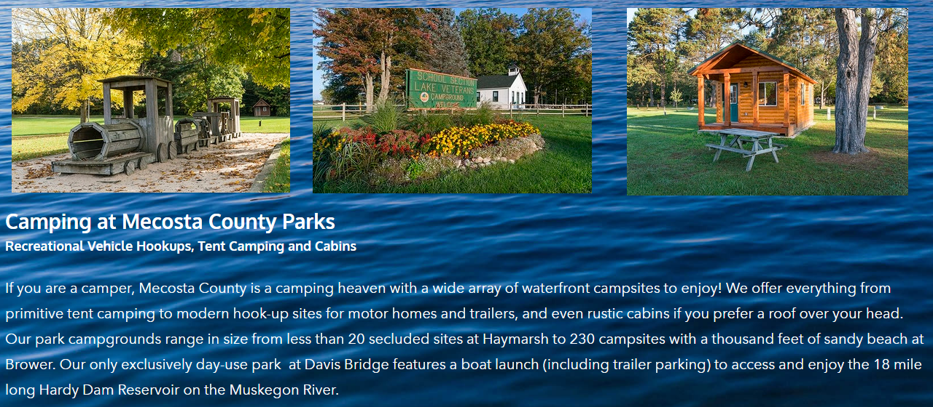
Mecosta County Parks Website
www.mecostacountyparks.com
Online Reservations
MCPC Board Minutes
Rules and Regulations
Park Information
Encourage our visitors to like our pages on Facebook for the Park Commission, Brower, School Section, Merrill-Gorrel & Paris Parks.

Slide 6
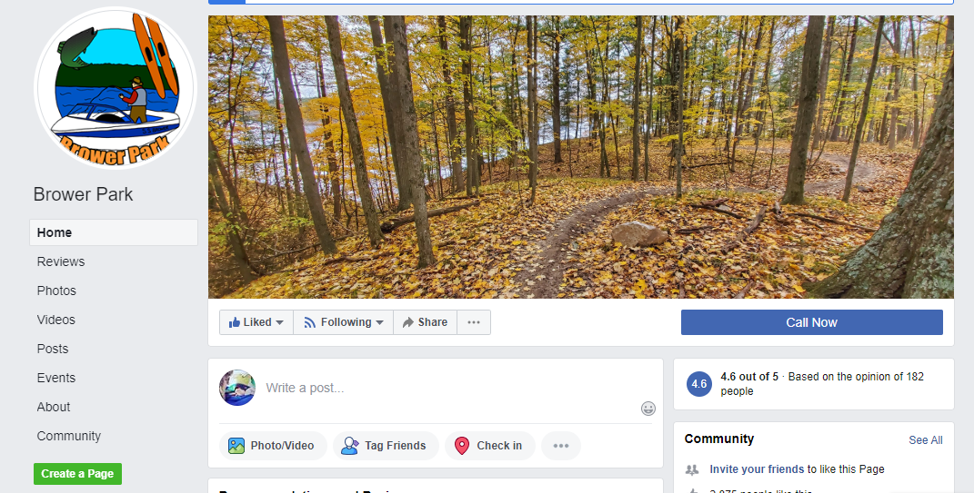
Pages on Facebook
www.mecostacountyparks.com
Park Commission
Brower Park
School Section
Paris Park
Merrill Gorrel Campground
Notes:
Encourage our visitors to like our pages on Facebook for the Park Commission, Brower, School Section, Merrill-Gorrel & Paris Parks

Slide 7
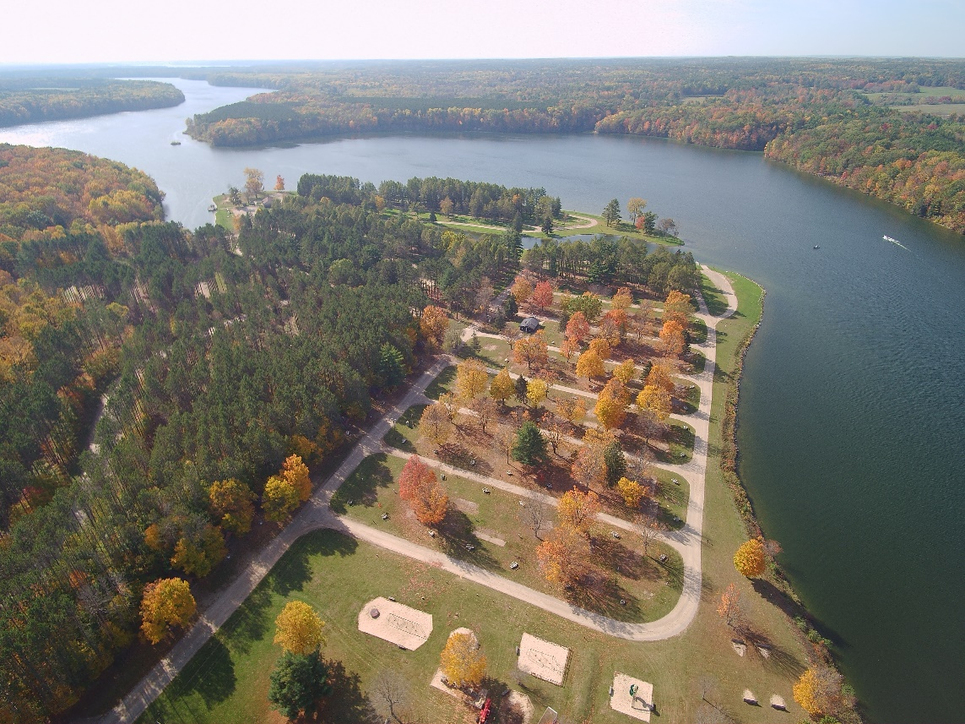
Brower Park
Located in Stanwood, MI
Pets Friendly since 2018
280 Acres
230 Sites + 10 Cabins
21/31 Night Rule
Lottery in Sept. for 120 seasonal sites
3 Modern Shower Buildings
Open Late April – Early October
Amenities
Camping
Boating (only park to have daily boat stickers)
Fishing
Family Activities
Crafts
Wagon Rides

Slide 8
Rules, Restrictions & Information Specific to Brower
Pet-friendly
21/31 night stay rule
Picnic Shelter available
Golf carts not allowed
Low Speed Vehicles allowed
Unattached Boat Trailer parking
Notes:
Pet-friendly since 2018
21/31 night stay rule – Pre/Post Season
One pavilion/picnic shelter available
Golf carts are not allowed
Low Speed Vehicles (LSVs) are allowed.
Unattached Boat Trailer parking

Slide 9
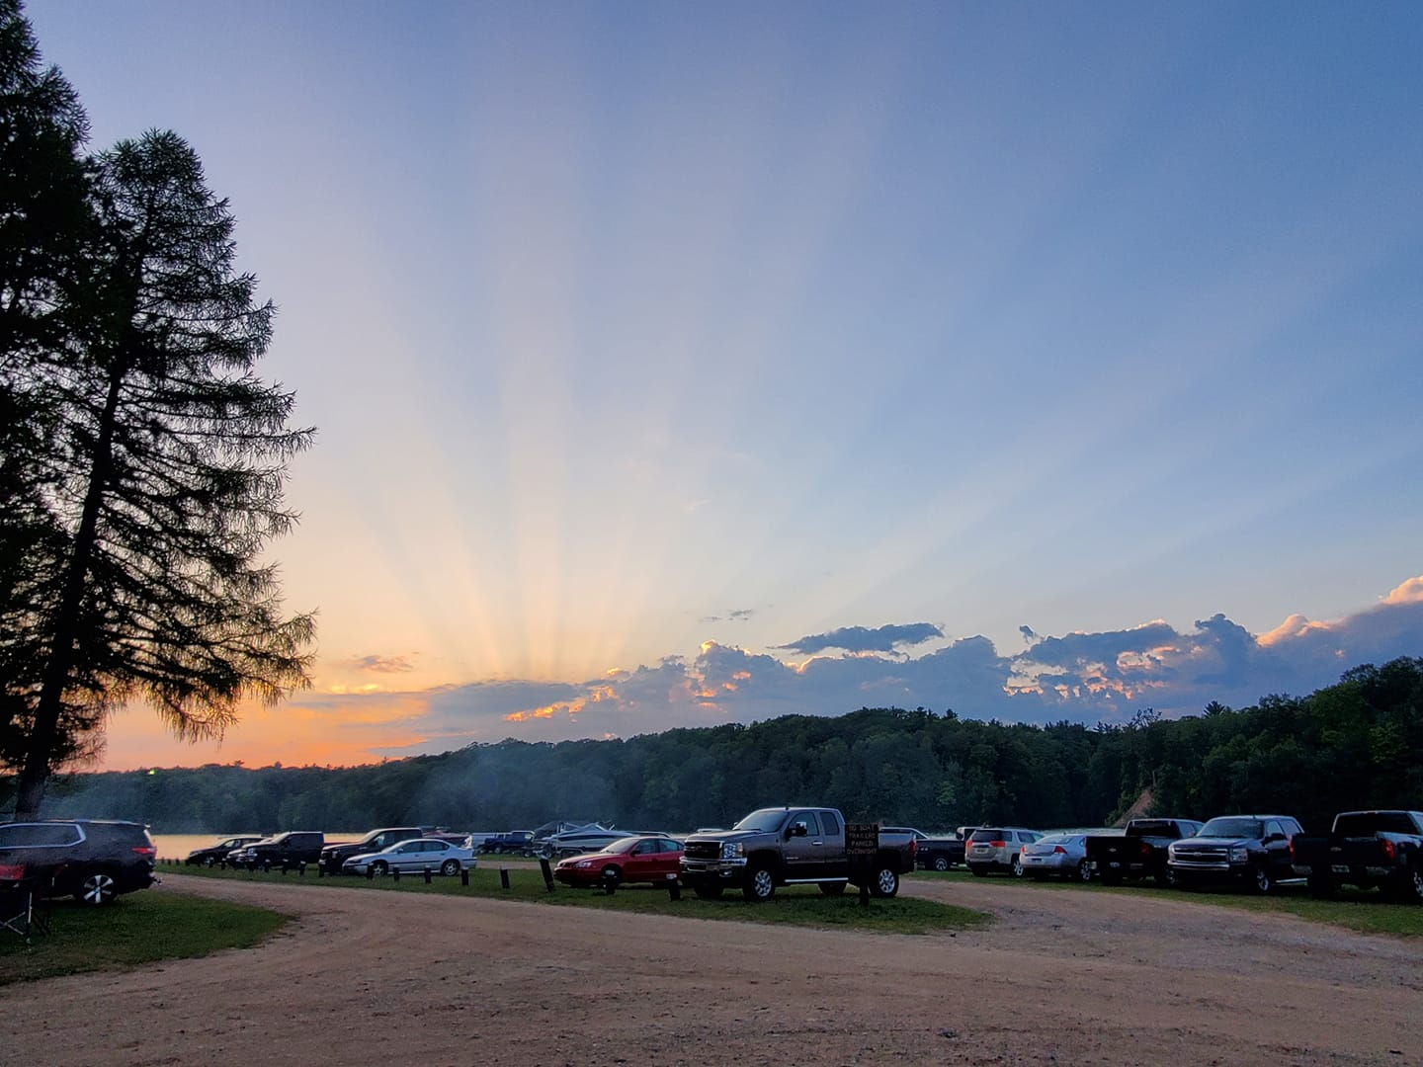

Slide 10
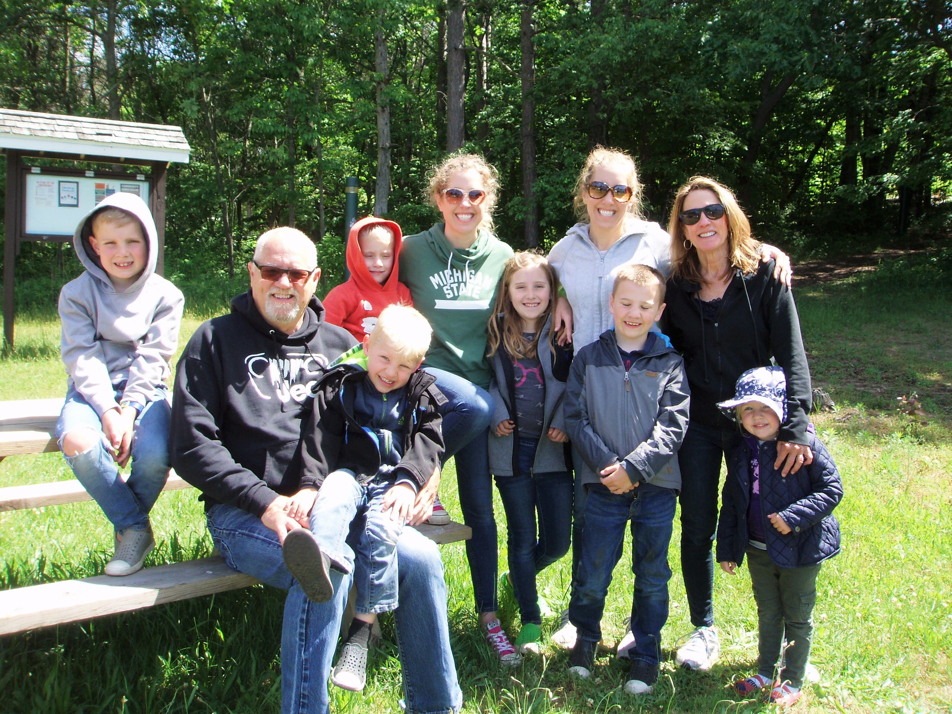

Slide 11
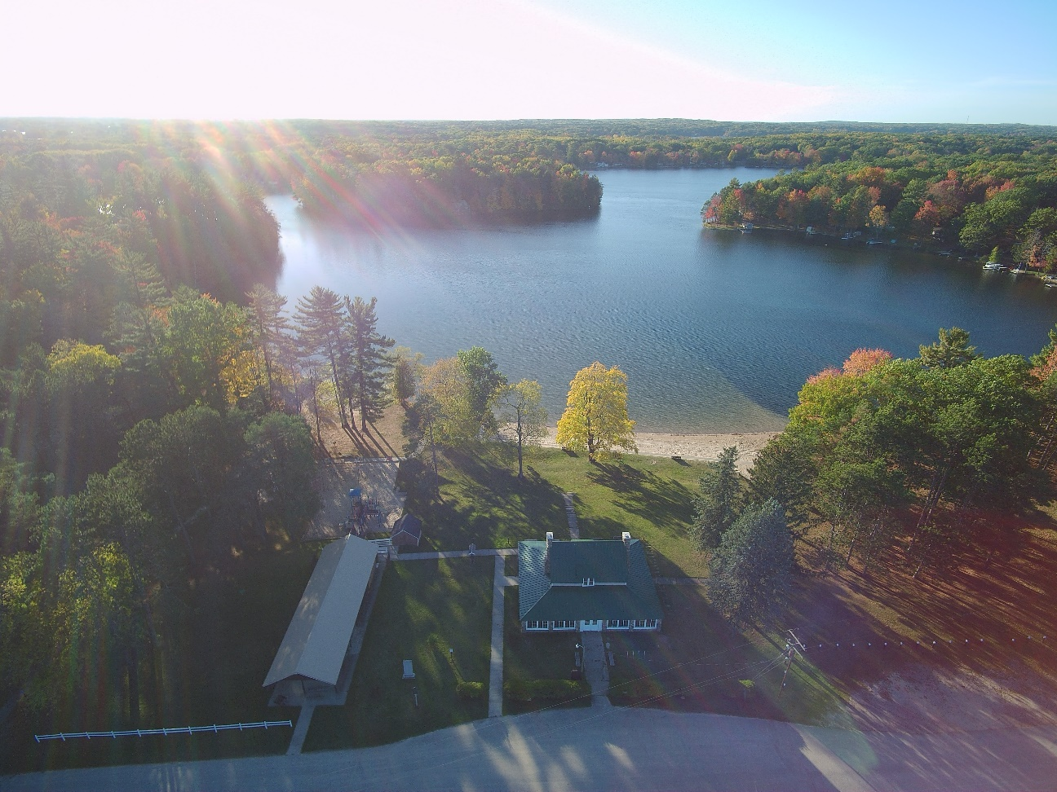
School Section Lake Veteran’s Park
Located in Mecosta, MI
No Pets Allowed
85 Acres
164 Sites +Cabins (2 Large & 5 Regular-sized)
96 Seasonal Sites
Open Early May – Late September
Amenities
Family Group Camp
Camping
Swimming
Small Boat Launch
Picnic Reservations
Fishing
Boat Rentals
Playgrounds
Crafts
Family Activities
70 Full Hook-up Sites
Park Operated Concessions

Slide 12
Rules, Restrictions & Information Specific to SSLVP
No pets
Family Group Camp
Historic Schoolhouse
Concession Store
Watersports Rentals

Slide 14
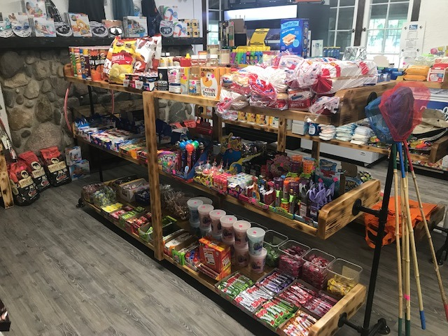

Slide 15
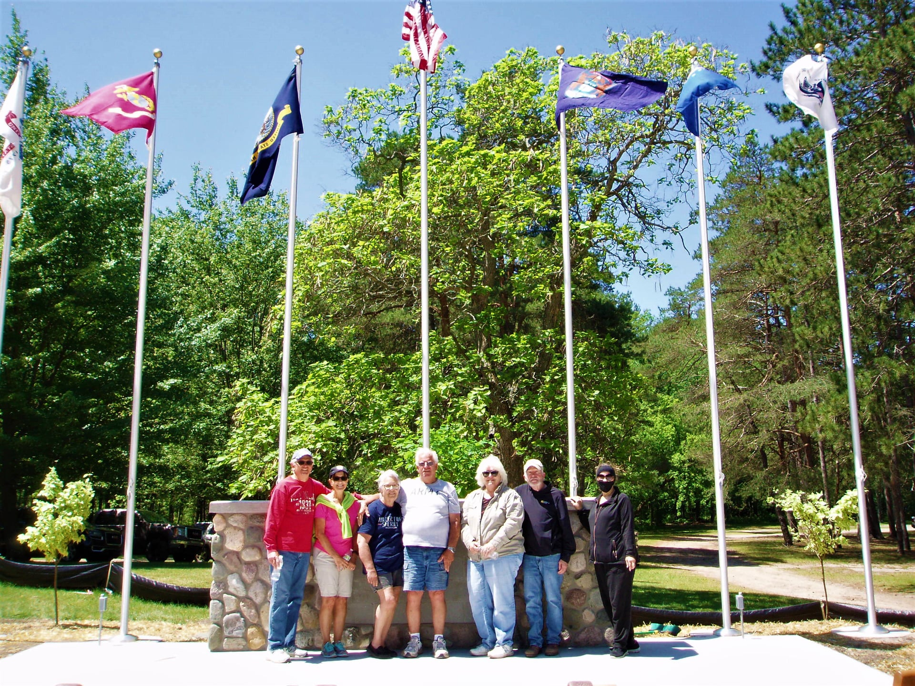

Slide 16
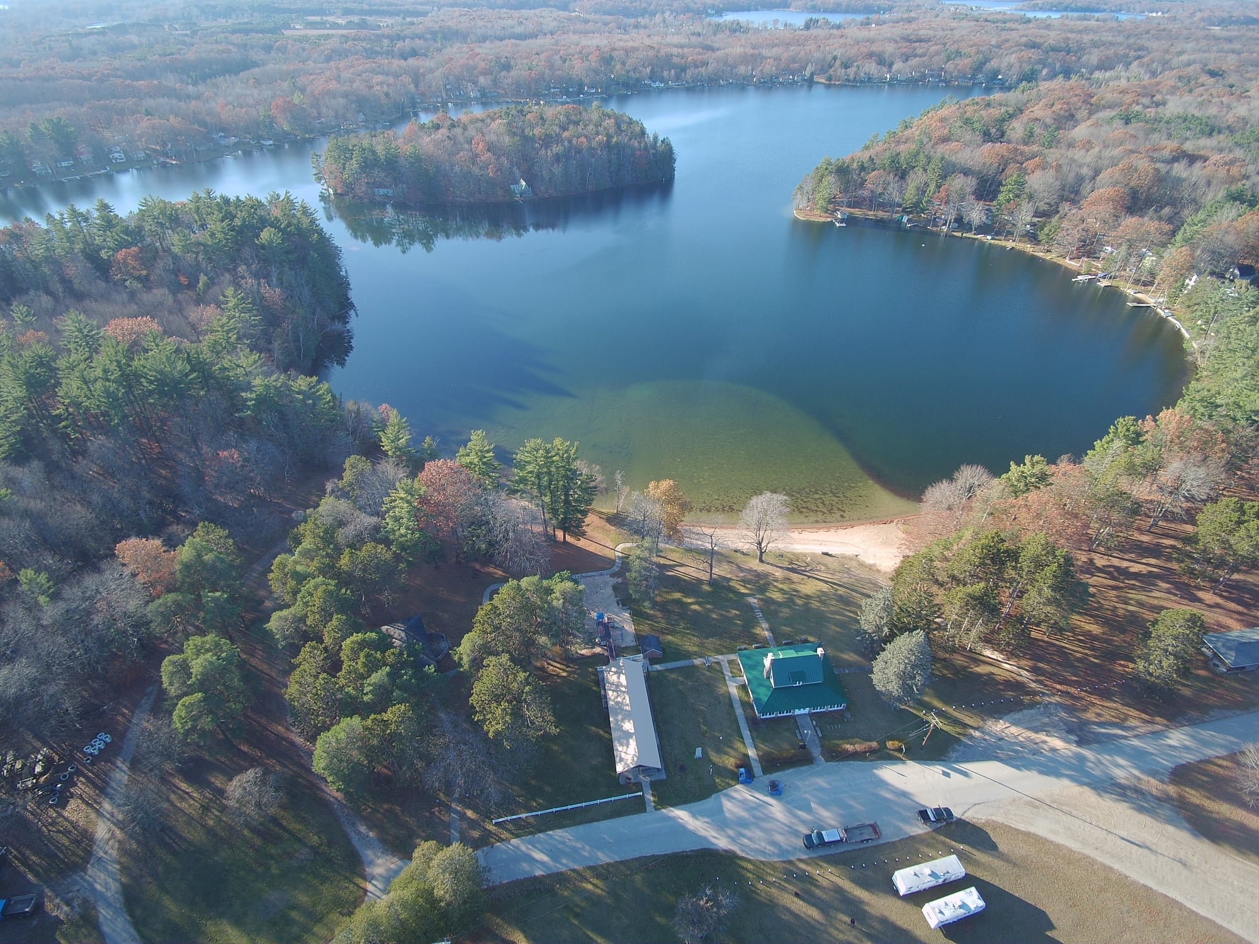

Slide 17
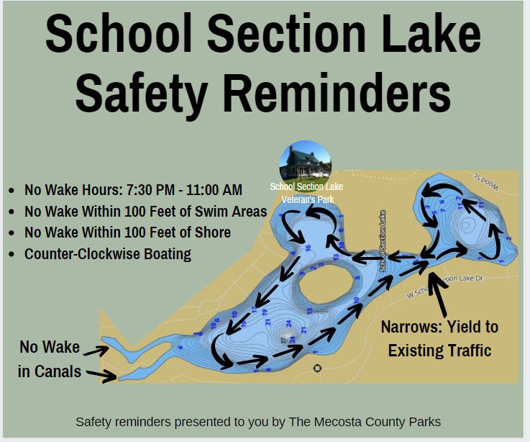

Slide 18
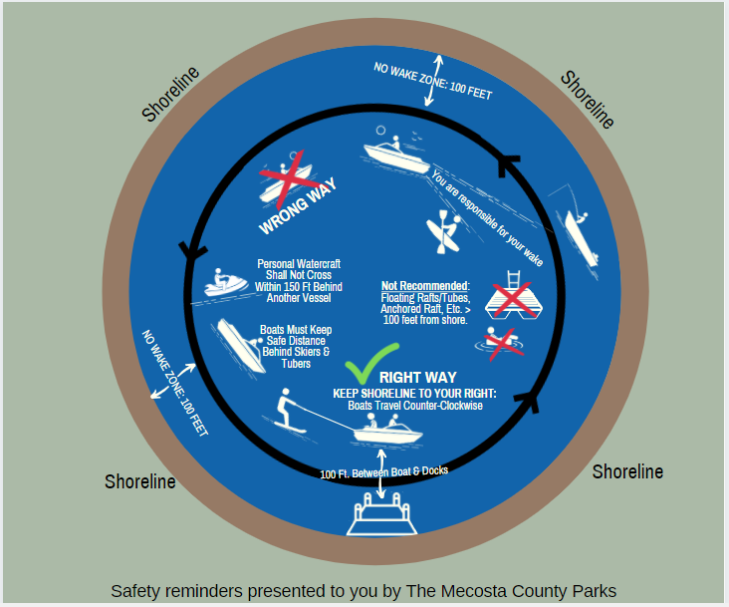

Slide 19
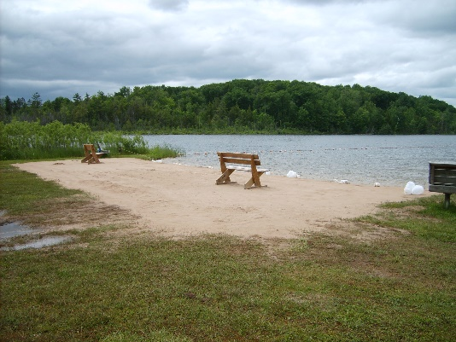
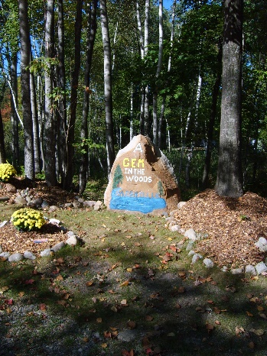
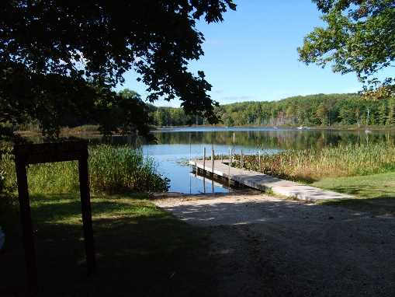
Merrill - Gorrel Campground
Located in Sears, MI
Pets Welcome
90 Acres
146 Camp Sites + 4 Cabins
Unlimited Seasonal Sites
Rustic Sites Available
Open Early May – Late September
Amenities
Two Lakes
Camping (Unlimited Seasonal Sites on Gorrel)
Fishing (Fishing Pier)
Small Boat Launch
Children’s Activities
In the Woods, Quiet

Slide 20
Rules, Restrictions & Information Specific to MGP
Pets are Allowed – 2 per campsite
Card’s Nest – private rental cabin
Stand up paddle board rentals
Notes:
Card’s Nest (Cabin on Gorrel side – does not belong to us – guests of this cabin come thru the park with a special sticker and may use our dumpsters)

Slide 21
Notes:
Card’s Nest (Cabin on Gorrel side – does not belong to us – guests of this cabin come thru the park with a special sticker and may use our dumpsters)

Slide 22
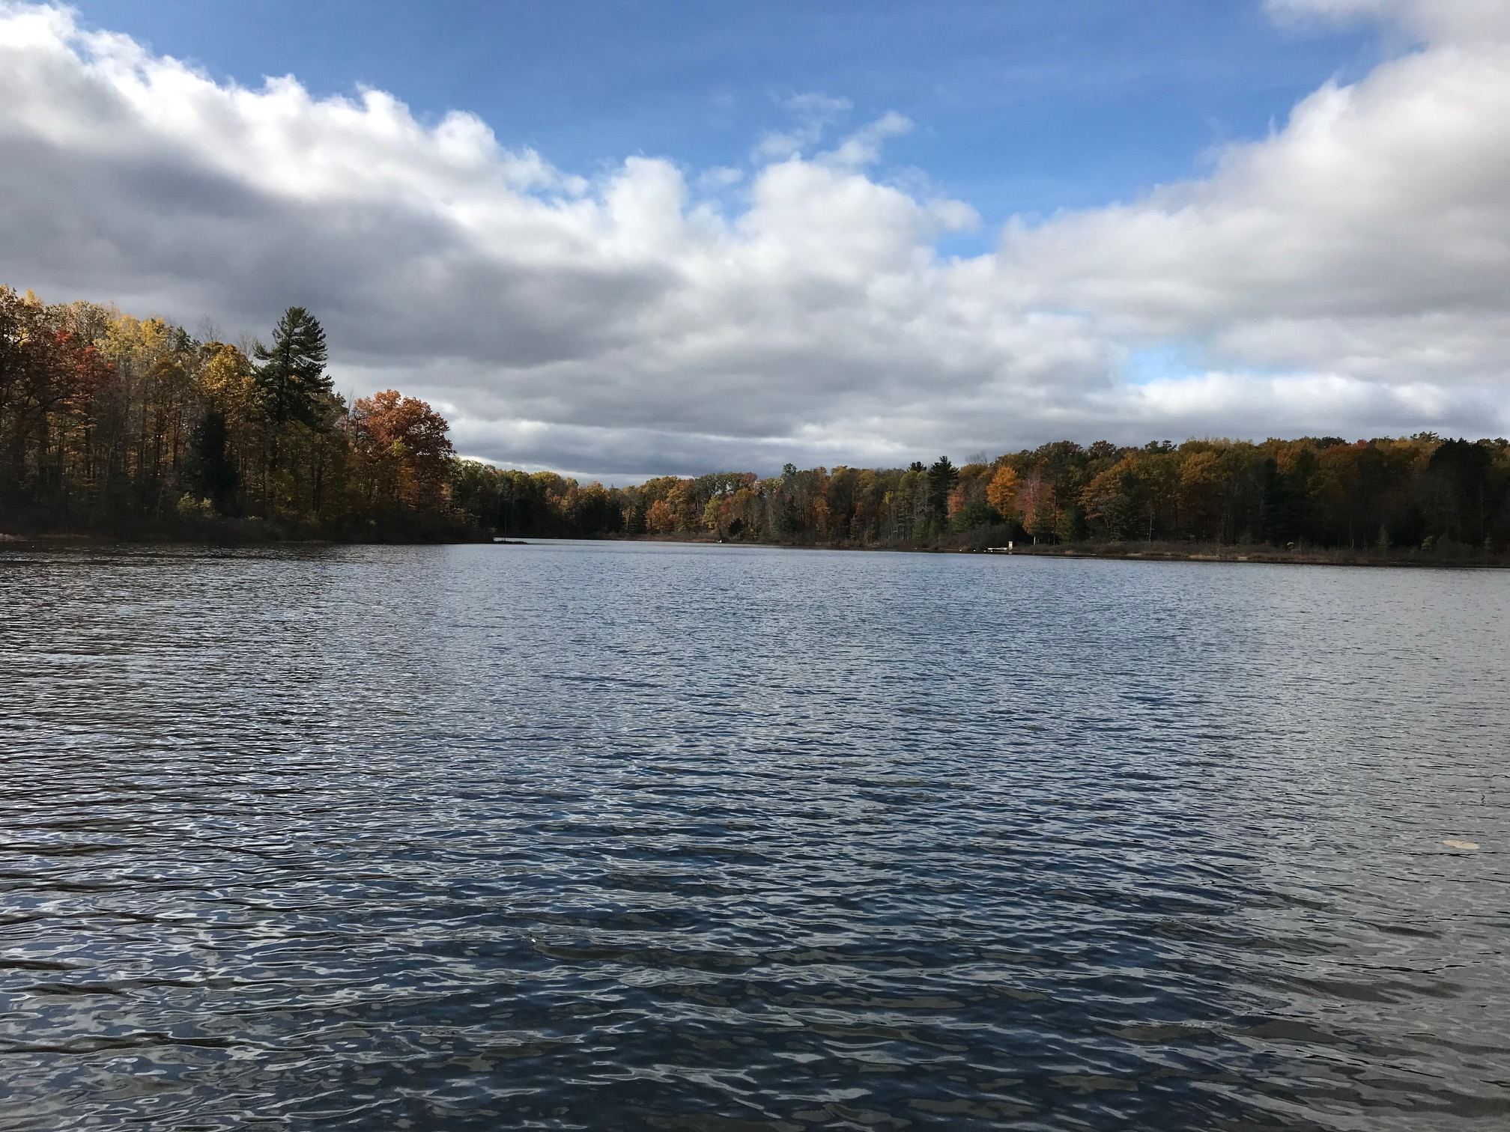
Notes:
Card’s Nest (Cabin on Gorrel side – does not belong to us – guests of this cabin come thru the park with a special sticker and may use our dumpsters)

Slide 23
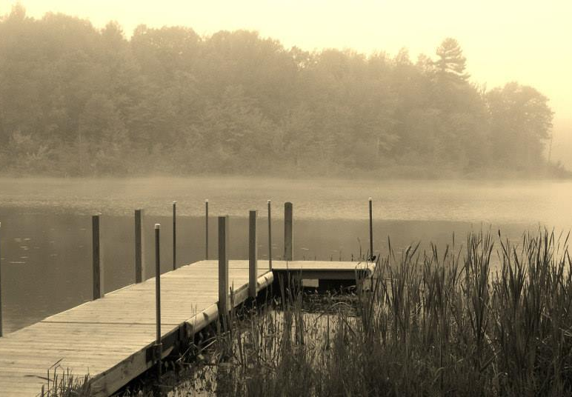
Notes:
Card’s Nest (Cabin on Gorrel side – does not belong to us – guests of this cabin come thru the park with a special sticker and may use our dumpsters)

Slide 24
Notes:
Card’s Nest (Cabin on Gorrel side – does not belong to us – guests of this cabin come thru the park with a special sticker and may use our dumpsters)

Slide 25
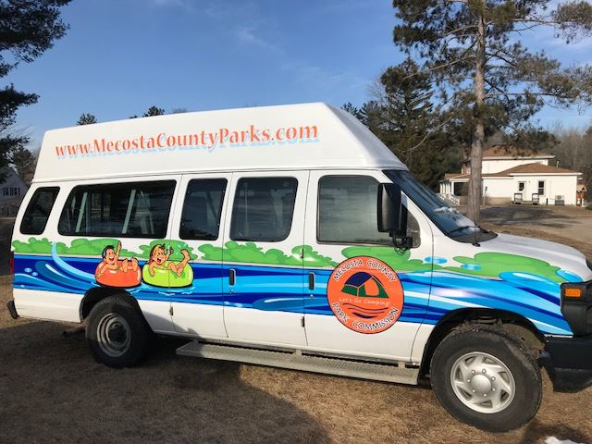
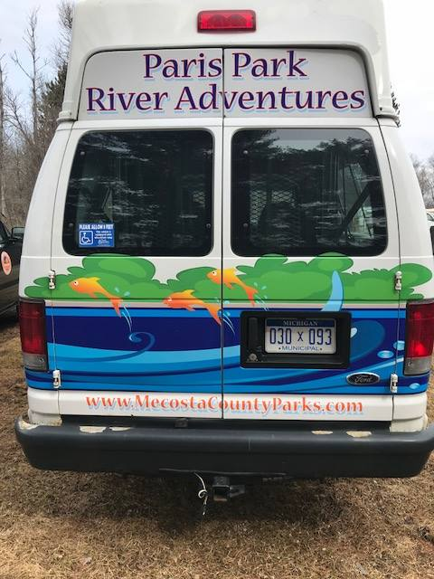
Paris Park
Located in Paris, MI
Pets Welcome
40 Acres
68 Campsites + 3 cabins
Unlimited seasonal sites
Open early May – Late September
Amenities
Camping
Full Hookup Sites
Canoe/Tube Launch
River Adventures
Fish Hatchery
Feed Fish & Birds
White Pine Trail
Indian Statue
Grafted Tree
Eiffel Tower
Smaller, Quiet Park

Slide 26
Rules, Restrictions & Information Specific to PP
Pets allowed - 2 per campsite
White Pine State Trail runs through Paris Park
Ponds/Hatchery
Group Campsites
River Adventures and Tube/Canoe launch
Notes:
Ponds – coin changer, fish food, bird food vending machines, dam boards, cleaning ponds area.
Group Campsites’ deposits: minimum of nine people X$5.00 each = $45.00 per night.
River Adventures and Tube/Canoe launch – vehicle fee and rental fee required from all guests using the launch.

Slide 27
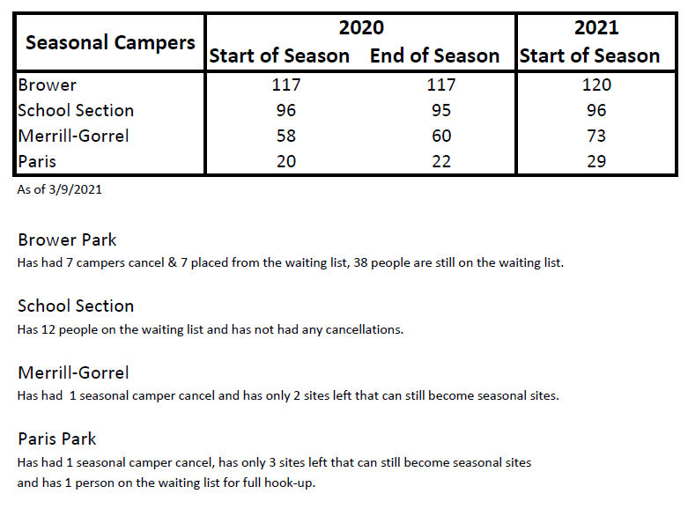
Seasonal Camper Report
Notes:
Special Events at School Section:
Old Settlers – Third Saturday in August
Wheatland Festival – weekend after Labor Day
Boaters Safety
Events Specific to Brower:
Big Boat/Hot Boat Weekend – weekend after Labor Day
Hydroplane races – Two weekends after Labor Day
Bass Tournaments
Boaters Safety

Slide 28
2021 Events
Notes:
Special Events at School Section:
Old Settlers – Third Saturday in August
Wheatland Festival – weekend after Labor Day
Boaters Safety
Events Specific to Brower:
Big Boat/Hot Boat Weekend – weekend after Labor Day
Hydroplane races – Two weekends after Labor Day
Bass Tournaments
Boaters Safety

Slide 29
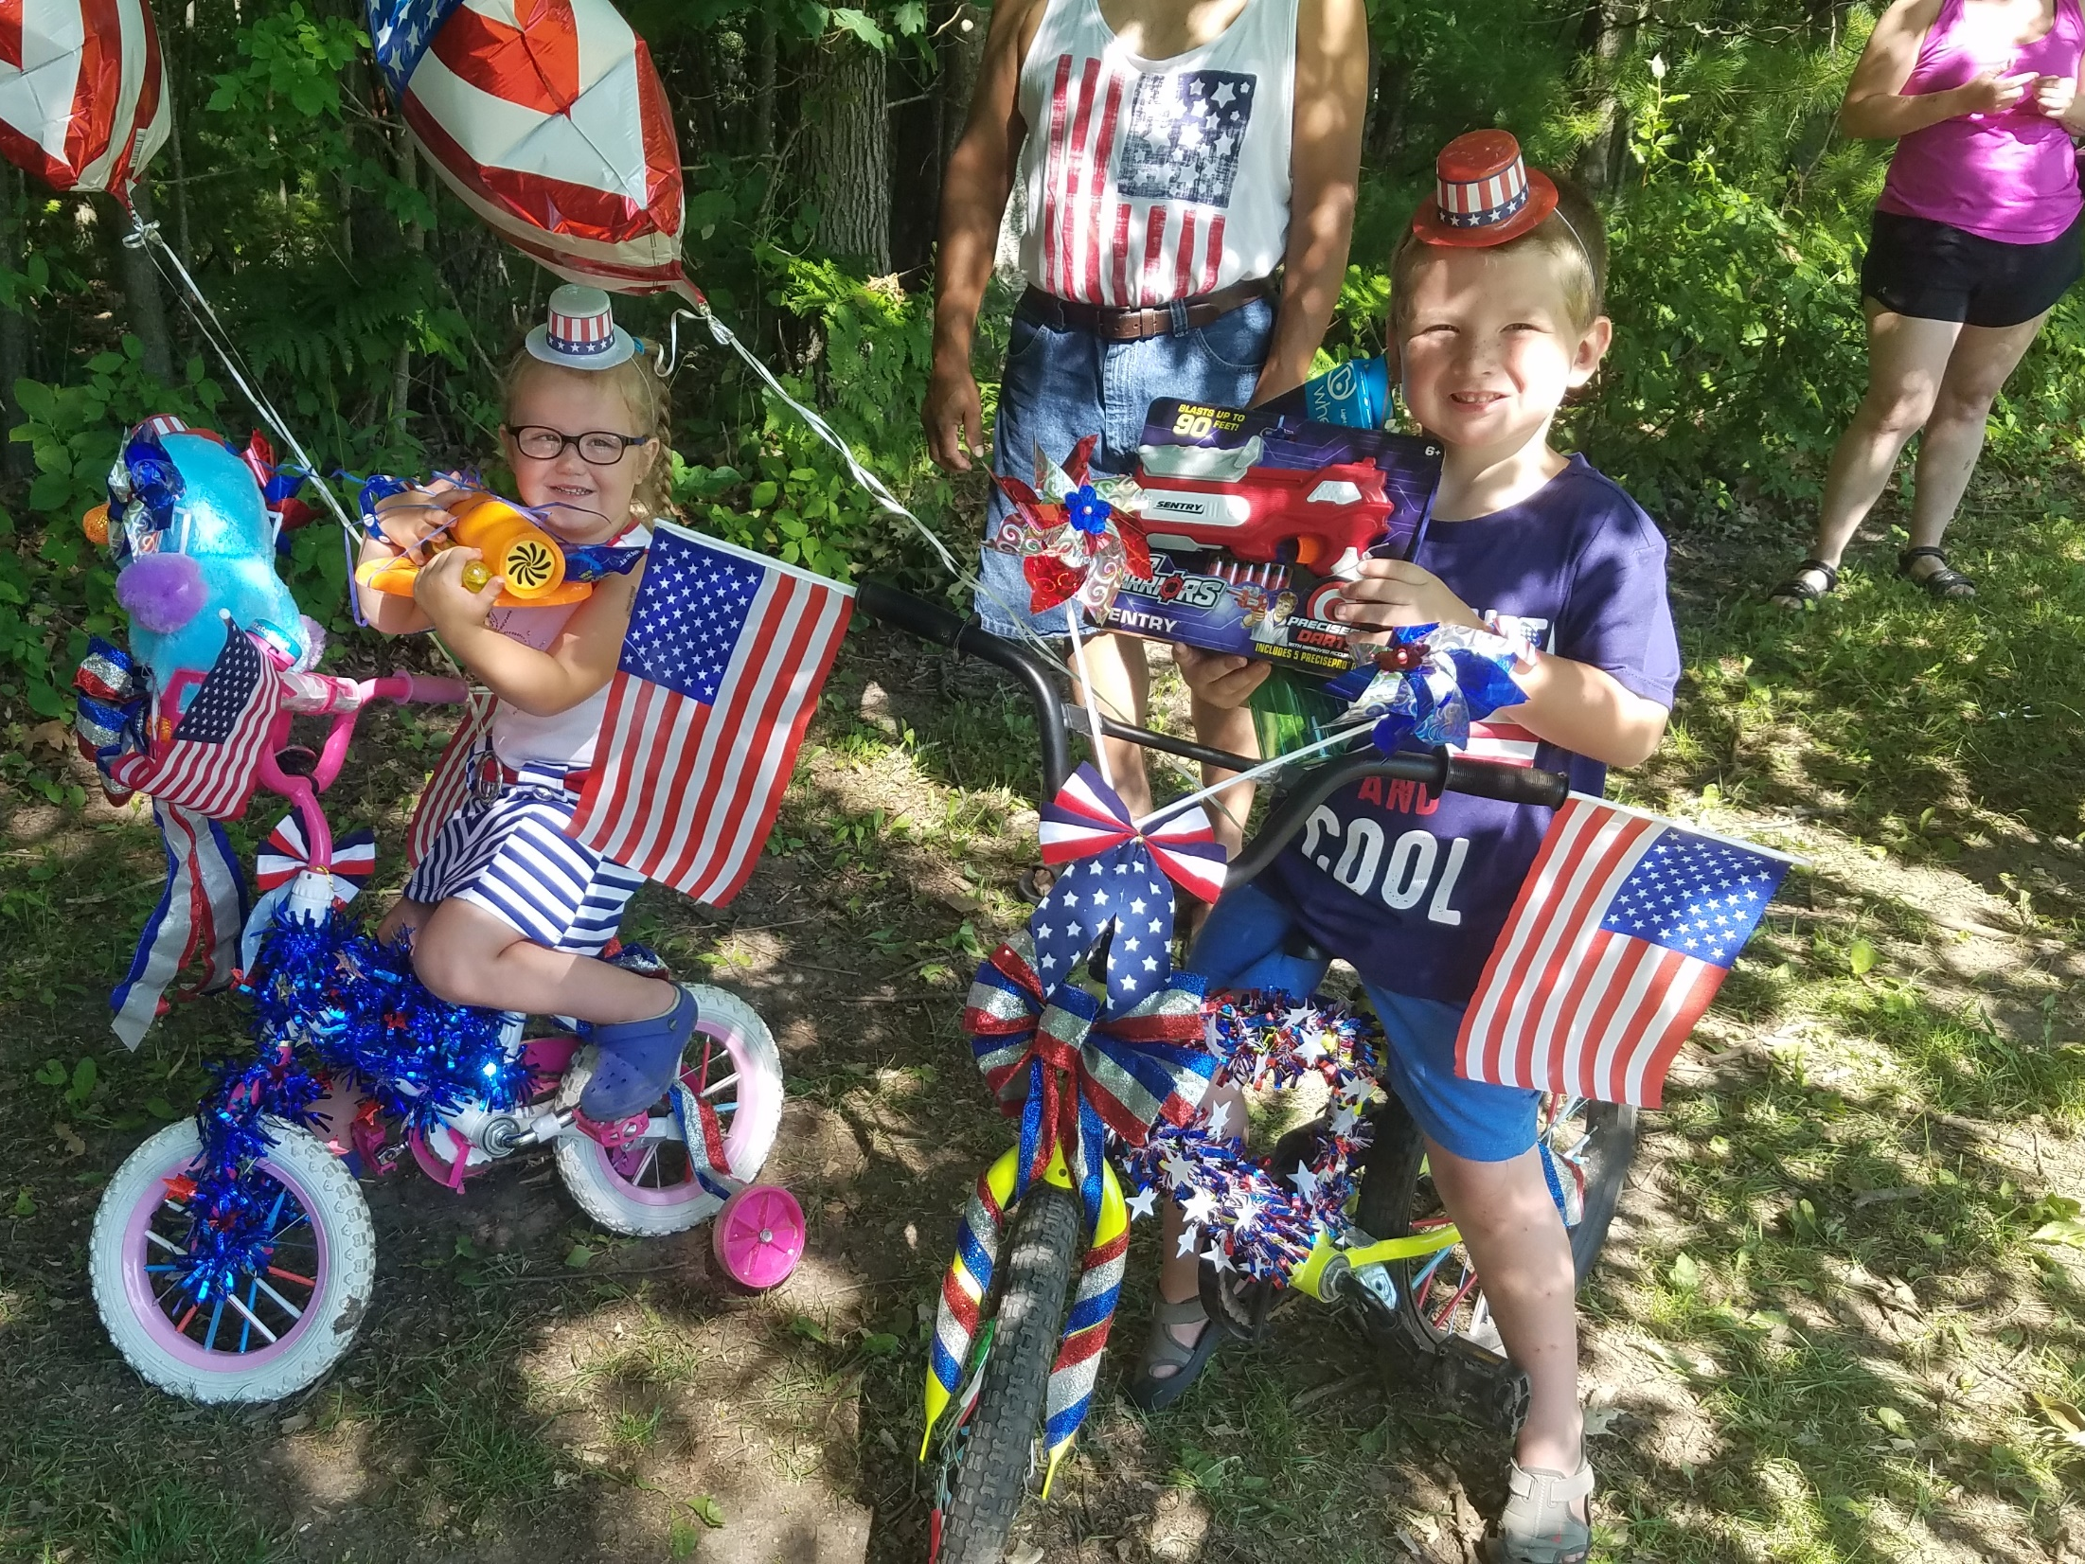
Notes:
Card’s Nest (Cabin on Gorrel side – does not belong to us – guests of this cabin come thru the park with a special sticker and may use our dumpsters)

Slide 30
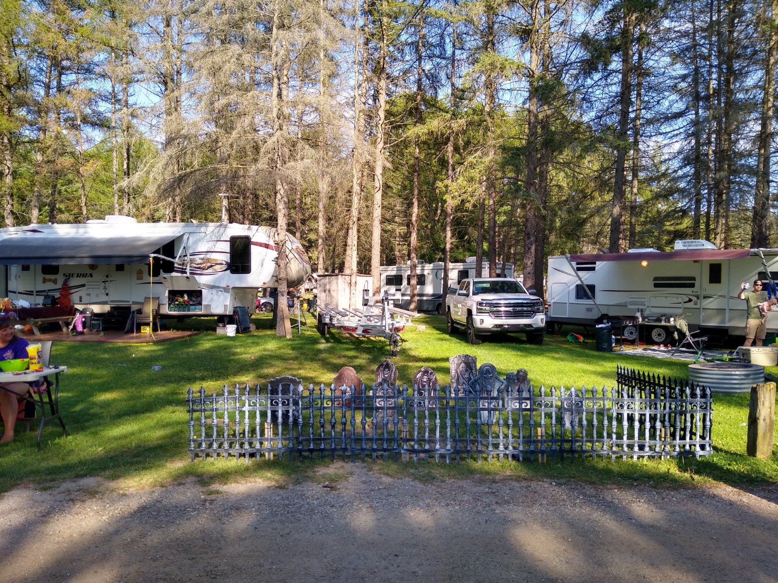
Notes:
Card’s Nest (Cabin on Gorrel side – does not belong to us – guests of this cabin come thru the park with a special sticker and may use our dumpsters)

Slide 31
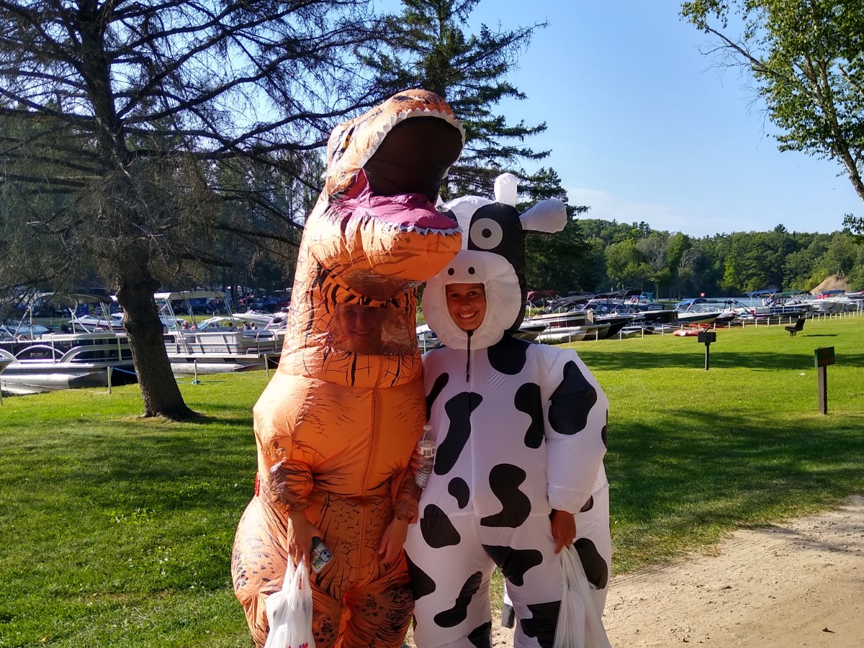
Notes:
Card’s Nest (Cabin on Gorrel side – does not belong to us – guests of this cabin come thru the park with a special sticker and may use our dumpsters)

Slide 32
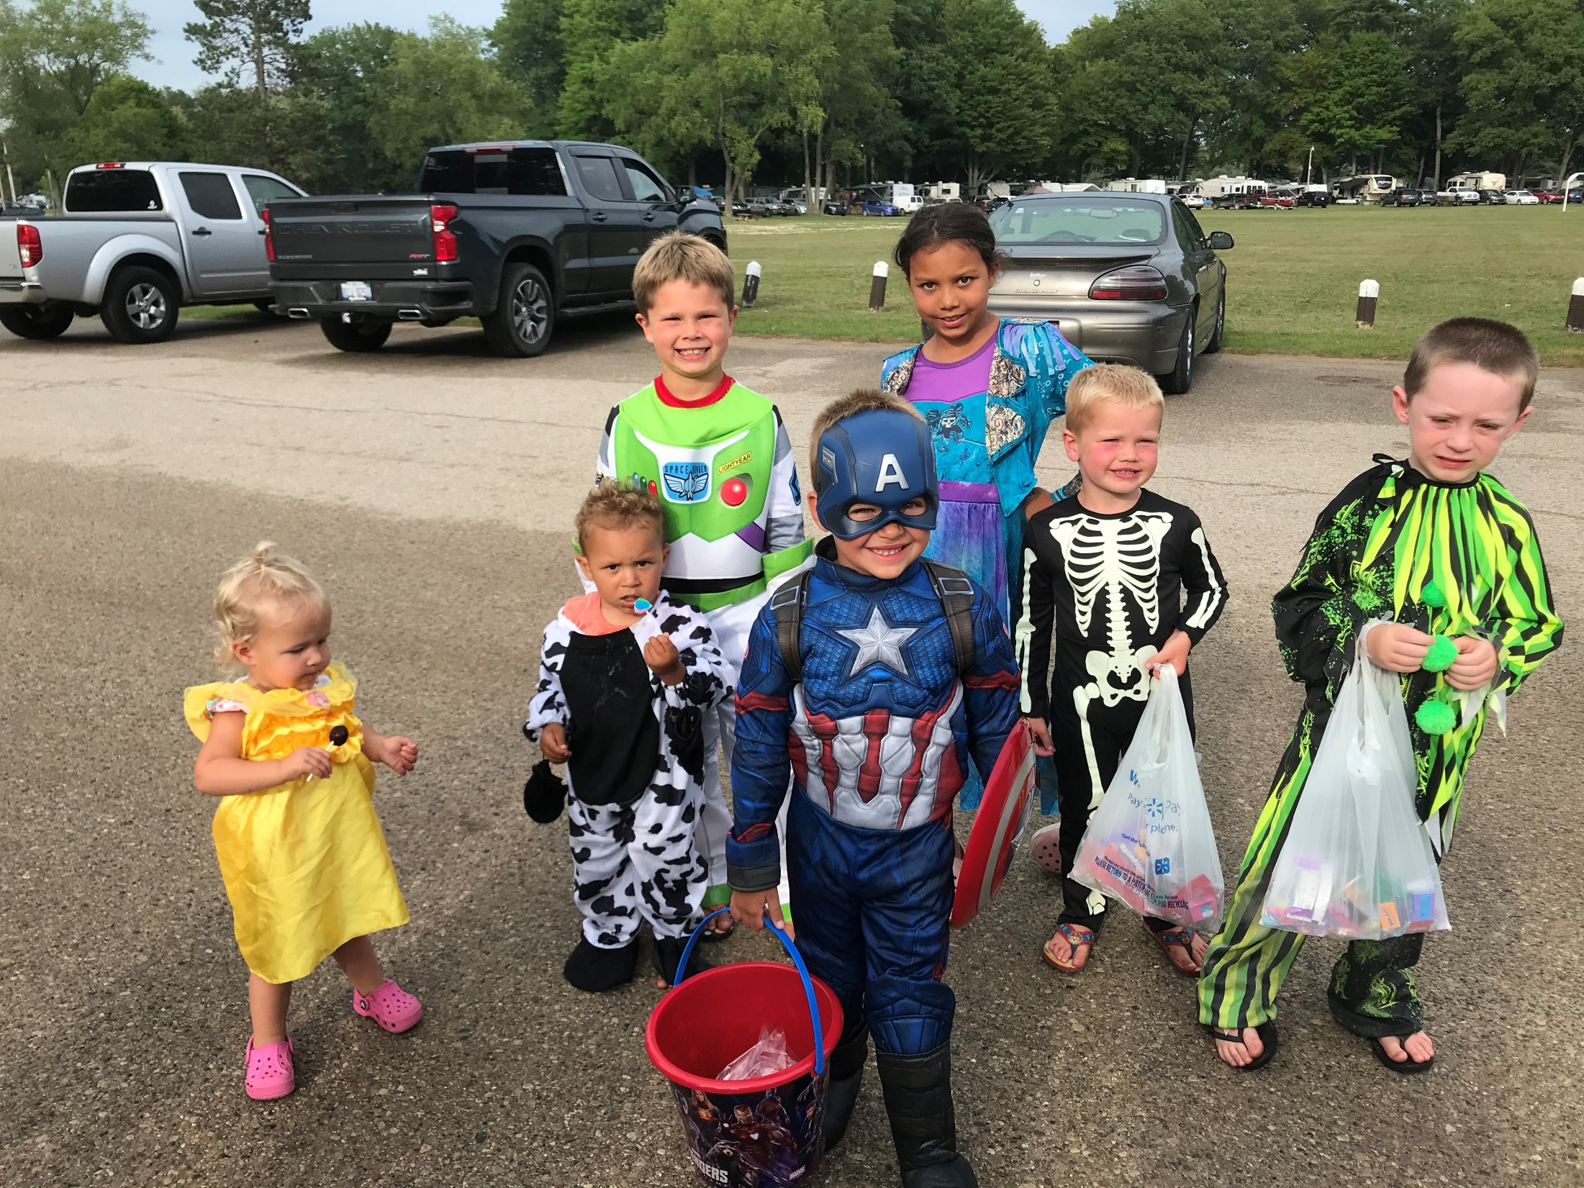
Notes:
Card’s Nest (Cabin on Gorrel side – does not belong to us – guests of this cabin come thru the park with a special sticker and may use our dumpsters)

Slide 33
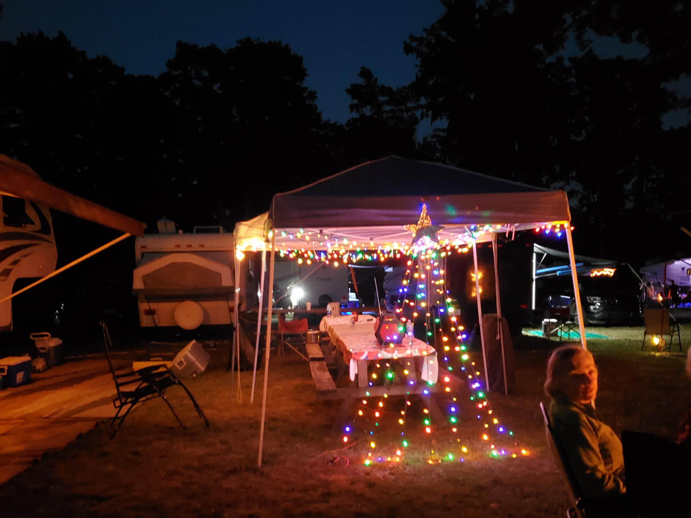
Notes:
Card’s Nest (Cabin on Gorrel side – does not belong to us – guests of this cabin come thru the park with a special sticker and may use our dumpsters)

Slide 34
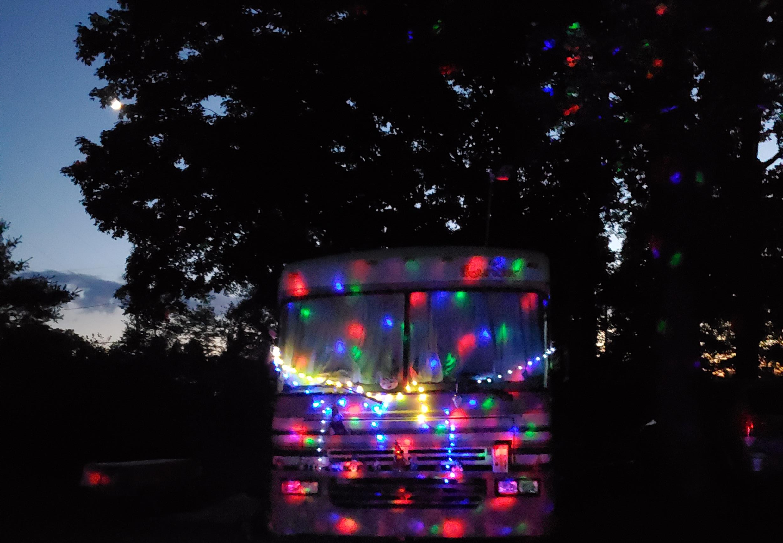
Notes:
Card’s Nest (Cabin on Gorrel side – does not belong to us – guests of this cabin come thru the park with a special sticker and may use our dumpsters)

Slide 35
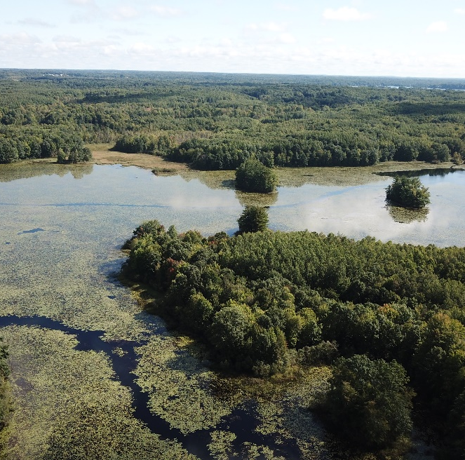
Tubbs Lake and Haymarsh
State Forest Campgrounds that are maintained by MCPC
Primitive Camping
Does not require vehicle permit for entry
Wildlife Habitat
Haymarsh is open until weather no longer allows
Tubbs open until Dec 1st

Slide 36
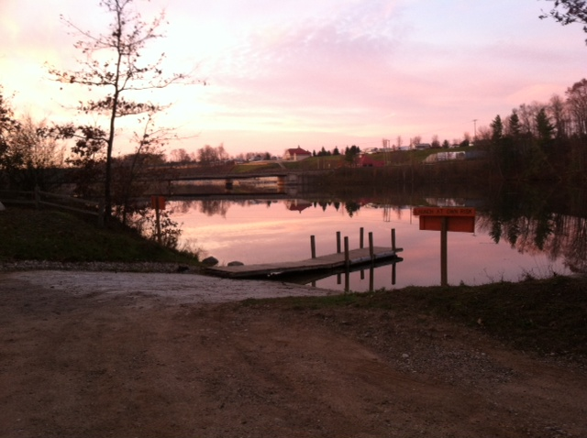
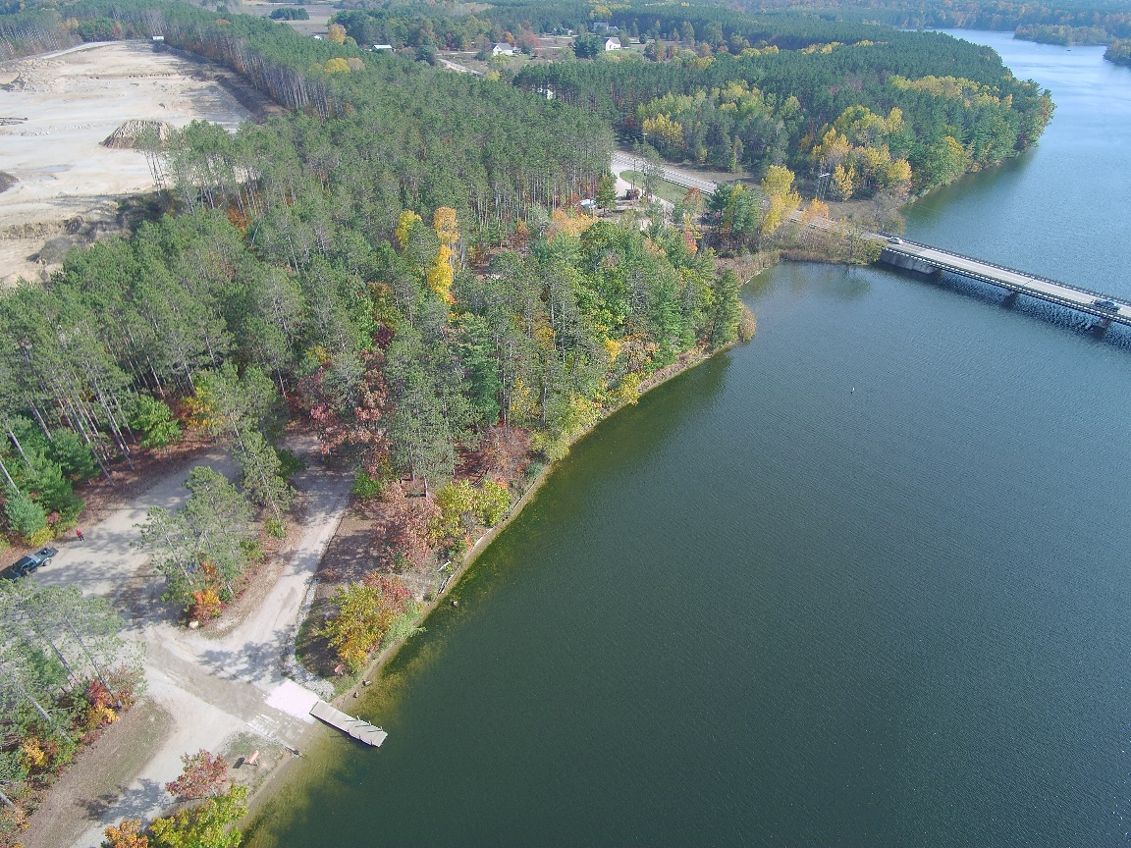
Davis Bridge
Located in Stanwood, MI
Day Use Only
Boat Launch
$7.00 Day Use
MCPC Season Vehicle sticker valid
Launch Closes when it becomes unsafe to launch a boat
Host camper

Slide 37
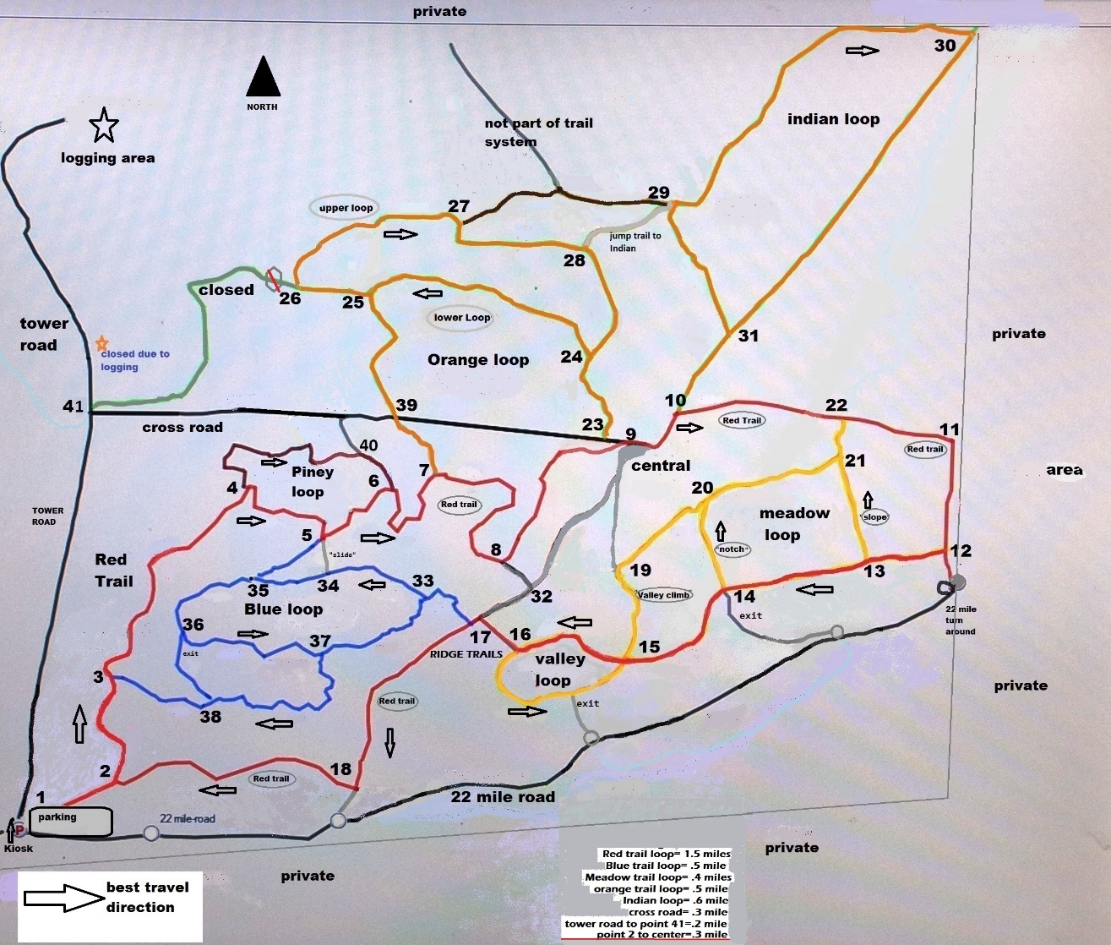
White Pine Valley Recreation Area
The park offers a serene nature environment with miles of clearly marked trails used for cross country skiing, snowshoeing, mountain biking, hiking, and walking.

Slide 38
People’s Choice Awards
Arts & Entertainment
Best Attraction
2nd place: School Section Lake Veteran’s Park
Best Family Entertainment
1st Place: School Section Lake Veteran’s Park
Best Tourist Spot
2nd Place: Paris Fish Hatchery
3rd Place: School Section Lake Veteran’s Park
Honorable Mention: Brower Park
Local
Best Campground RV/Park
1st Place: School Section Lake Veteran’s Park
2nd Place: Brower Park
Honorable Mention: Mecosta County Park Commission
Honorable Mention: Paris Park
Best Place to Work
Honorable Mention: Mecosta County Park Commission

Slide 40
Mission Statement
To preserve, protect and enhance the natural environment, through safe management practices and a positive, friendly, cordial attitude, we, the stewards of the Mecosta County Parks, will work constructively with coworkers and the public to provide unique recreational and educational opportunities for the residents and guests of Mecosta County.

Slide 41
Notes:
7 member county board
10 member park commission
Jeff + 4 more full time year round employees
Seasonal staff at parks ~40

Slide 42
Funding is generated from user fees within the parks, not supported by a tax appropriation.
Park Funding

Slide 44
People First
No individual with a disability, shall be excluded participation in or denied benefits of services, programs or activities or be subjected to discrimination
Service dogs are allowed in all parks.
Notes:
Per ADA, no individual with a disability, because of their disability, shall be excluded participation in or denied benefits of services, programs or activities of a public entity, or be subjected to discrimination by any such entity.

Slide 45
Board Meetings
5:00 PM: 3rd Tuesday of the month
Administrative Office in Paris
Meeting dates and times are subject to change.
Meeting notices must be posted in the parks.

Slide 46
General Information
Parks overview

Slide 48
Reservation Requirements
Two night minimum stay required
One night stay available for walk-ins.
Three night stay required for reservations including a holiday.

Slide 49
Reservation Requirements
100% payment is required at time of reservation
Payments accepted by credit cards, cash, check or money order.

Slide 50
Reservation Information
Notes:
The Refund Policy will be covered later, including how to re-schedule arrival dates

Slide 51
Reservation Information
Notes:
The Refund Policy will be covered later, including how to re-schedule arrival dates

Slide 52
Online Reservations
Rate
Photo of site
Sun/Shade
Dimensions of Site
Recommended type and size of camping unit
Seepage Pit
Made at www.MecostaCountyParks.com
Notes:
Made at www.MecostaCountyParks.com

Slide 53
Holiday Rate Dates
Memorial Day: Fri, Sat, and Sun. (May 28, 29, & 30)
Independence Day: Thurs - Sun. (July 1, 2, 3 & 4)
Labor Day Weekend: Fri - Sun (Sept. 3, 4 & 5)
Hot Boat Weekend: Thurs. - Sun. (Sept. 9, 10, 11 & 12).

Slide 54
Employee Discount on Camping
50% of weekday/weekend base rate.
Must be reserved by Operations Manager or Superintendent
Sites are for employees
Notes:
(family is welcome to stay the night with the employee, however, the site cannot be sublet for ANY reason).

Slide 55
Minimum Stay Requirements
Two-night minimum stay required except:
Three-night minimum:
Memorial Day –reservations beginning Fri or Sat
July 4th – reservations beginning Thurs, Fri or Sat
Labor Day – reservations beginning Fri or Sat
Hot Boat – reservations beginning Thurs, Fri or Sat

Slide 56
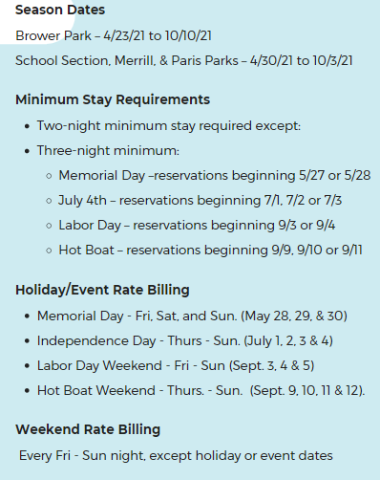
Season/Rate Information

Slide 57
Reservation Requirements
One night stay for walk-ins
100% payment is required to hold site
Payments accepted by credit cards, cash, check or money order.

Slide 58
Each Campsite is Limited to:
1 camping unit
2 motor vehicles
1 additional tent
1 trailer (utility or boat) kept on campsite.
No more than 8 persons per campsite
Notes:
Must be 18 to register for site and an adult must be present at all times.
(Anything in excess of this list requires the purchase of an additional campsite.)

Slide 59
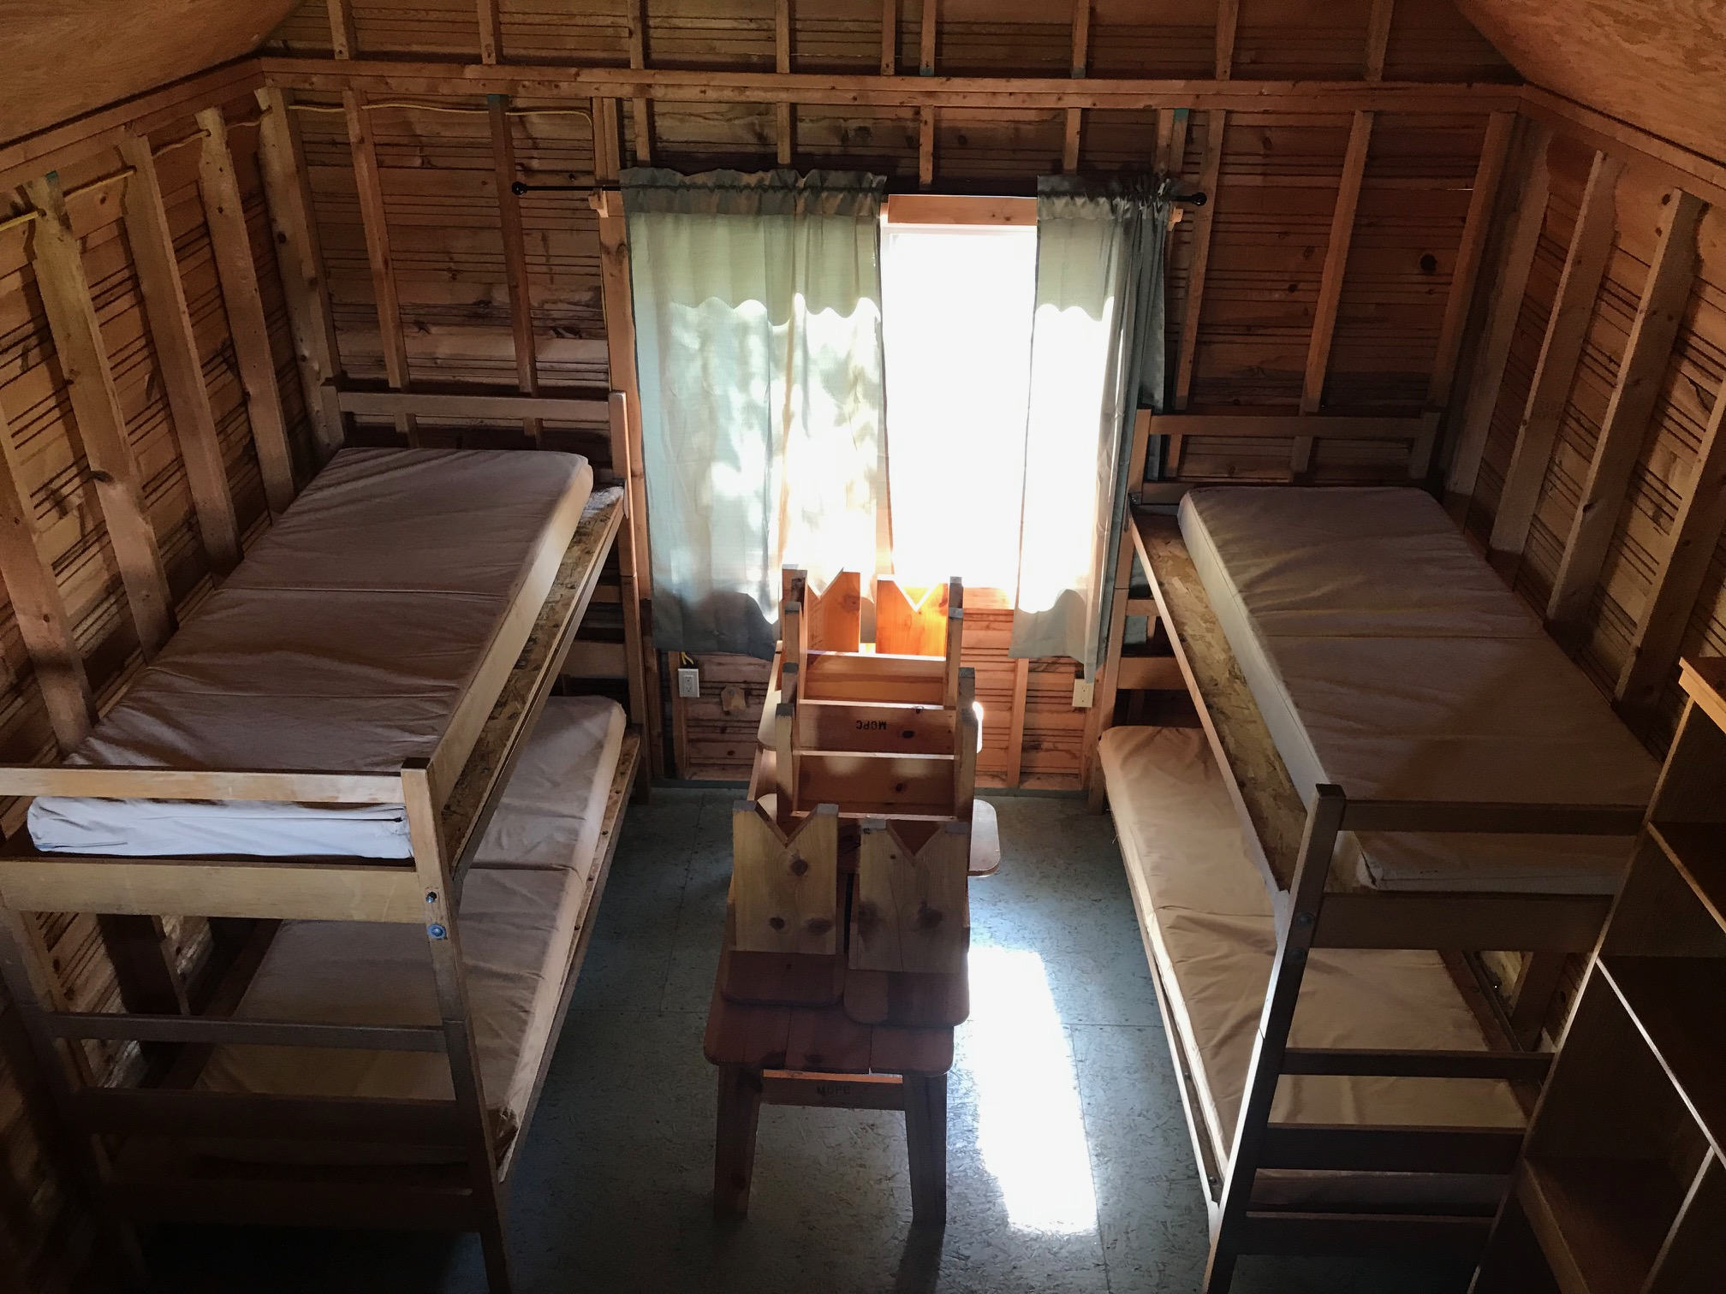
Cabin Information
Notes:
Sleep up to 6 people (Paris sleeps 4 and does not have a loft); one additional tent is allowed on the site, however, only 8 total guests are allowed on a site.
Visitors must bring bedding.

Slide 60
Cabin Information
Covered porch
Picnic table
Fire ring with grill
Water hookup
Two sets of bunk beds and a mattress in loft
Inside table with benches, shelving to store clothing, two chairs, small benches
Electricity inside the cabin (lights and outlets)
Pets are not allowed in cabins unless they are service animals.
Notes:
Sleep up to 6 people (Paris sleeps 4 and does not have a loft); one additional tent is allowed on the site, however, only 8 total guests are allowed on a site.
Visitors must bring bedding.

Slide 61
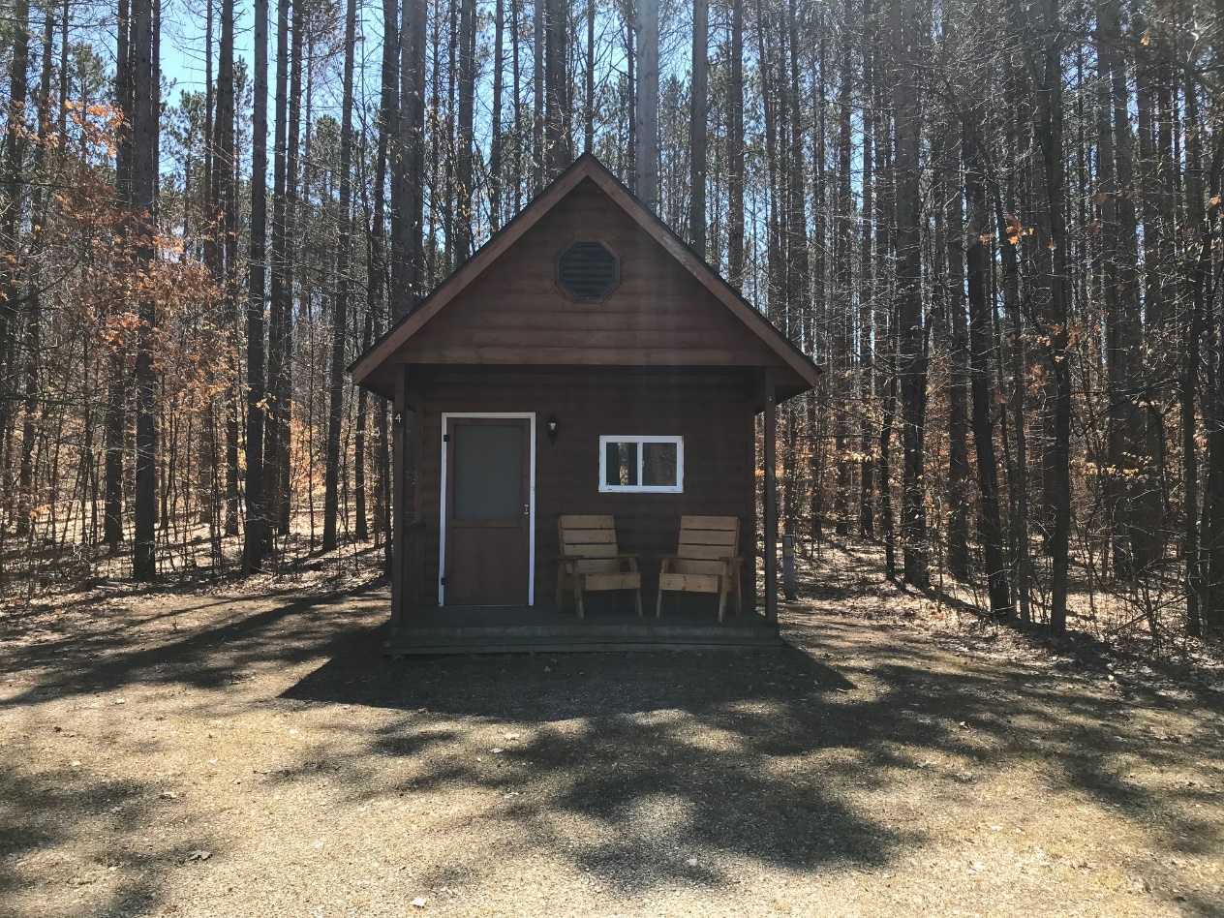
Cabin Information
Notes:
Sleep up to 6 people (Paris sleeps 4 and does not have a loft); one additional tent is allowed on the site, however, only 8 total guests are allowed on a site.
Visitors must bring bedding.

Slide 62
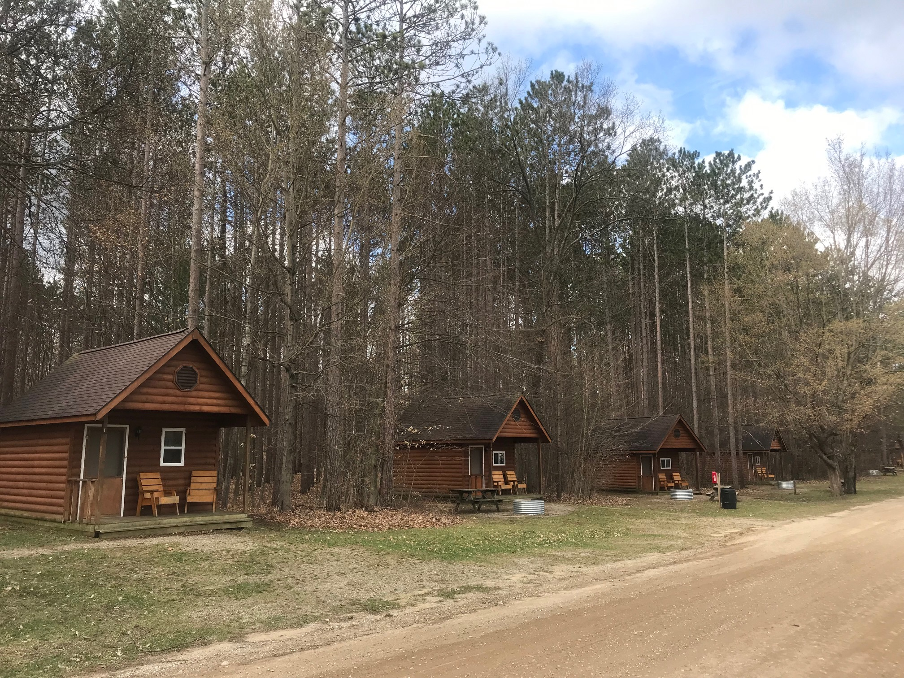
Cabin Information
Notes:
Sleep up to 6 people (Paris sleeps 4 and does not have a loft); one additional tent is allowed on the site, however, only 8 total guests are allowed on a site.
Visitors must bring bedding.

Slide 63
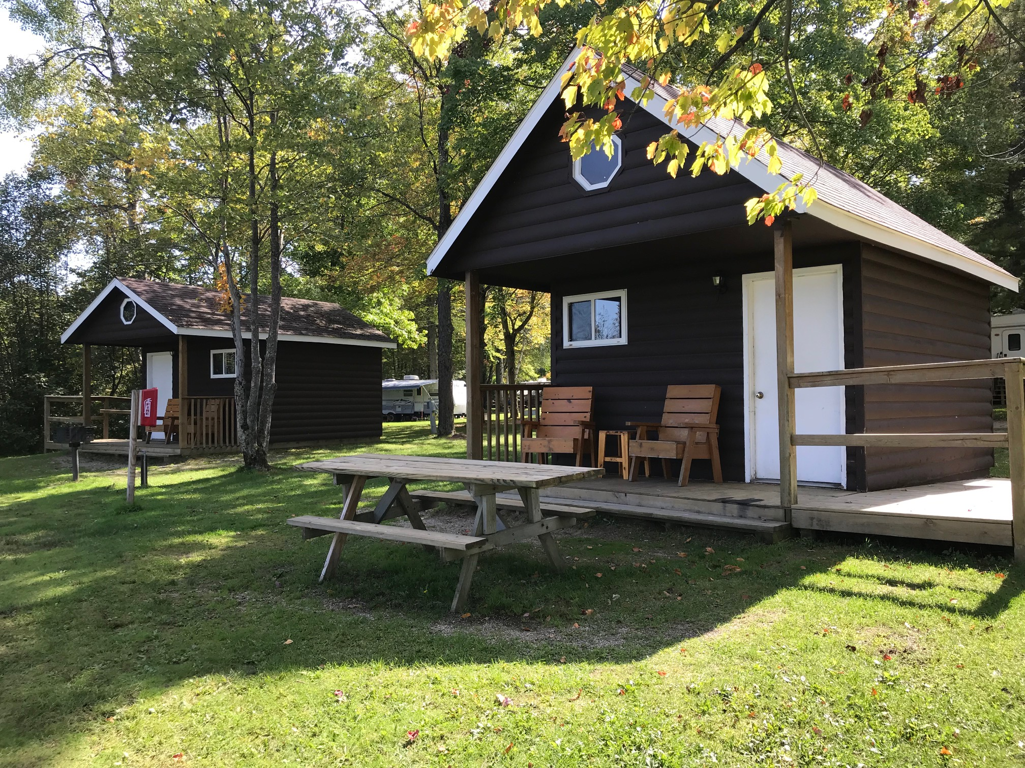
Cabin Information
Notes:
Sleep up to 6 people (Paris sleeps 4 and does not have a loft); one additional tent is allowed on the site, however, only 8 total guests are allowed on a site.
Visitors must bring bedding.

Slide 64
Picnic Shelter Reservations
Available 8:00 AM – 10:00 PM
Picnic Release forms are required for all rented picnic or shelters.
Notes:
If an area is not reserved a camper may use the shelter or picnic area.
The fee guarantees a specific shelter building at a specific date.

Slide 65
Winter Storage
Merrill-Gorrel, School Section and Paris Parks: kept on campsite
Brower Park : kept in storage area
Can store deck and/or storage shed for additional fee
Notes:
Registered seasonal campers may pay and leave camping unit over the winter.
Camping units at Merrill-Gorrel, School Section and Paris Parks may be left in place on the guest campsite.
Camping units at Brower Parks are to be moved to the designated storage area during the final week of the season and before check-out time on the last operating date of the camping season.
All camping units are to be removed from the storage area on the opening week of the following season.
Only camping units and internal contents are allowed to be stored. No outside equipment will be allowed. Decks, grills, storage containers, etc.. must be removed from the campsite.
Camper must be disconnected from all utilities with connections stored internally.

Slide 66
Change of Campsite or New Seasonal Camper Process
Available with seasonal packets in July/August
A deposit is required
8 campsites can be requested
Notes:
No change of site/new seasonal site request forms will be accepted until seasonal camper informational packets are made available to all current campers. These informational packets are distributed to the parks in August of each season. The packets may be obtained by contacting the individual park office or the parks administration office.
A $100 Deposit is required with the acceptance of each request form. For current seasonal campers, this deposit can be made on their current site pending the availability of a new site.
The change of site/new seasonal site request form will allow each camper to request up to 8 campsites as their primary options. These forms will be sent to the parks administration office once completed and deposit received.
No change of site/new seasonal site request will be processed until the deposit deadline for returning seasonal campers has expired. The deadline to complete a request form will be the same as the deadline for returning seasonal camper deposits.

Slide 67
Seasonal Camper Lottery Process
Current seasonal campers who wish to move
All new seasonal camper requests
Two Separate Lotteries:
Notes:
After returning seasonal sites have been confirmed by deposit, a lottery drawing will occur which will determine the processing order for all change of site request of current seasonal campers.
A second lottery drawing will be held, following the change of site request lottery, for all new seasonal request to determine the order of processing.
The lottery drawings will take place at the administrative building in Paris, Michigan. These drawings will simply determine the order in which we process request forms. The date and time of the lottery drawing will be listed in the seasonal camper informational packets. Public is welcome to attend as the processing order is determined, however actual processing will not be accomplished during the lottery drawing date. It may take 2-3 weeks to process all request throughout the park system.
All change of site requests from current seasonal campers will be processed before the processing of new seasonal request begins.
Processing of sites will be done in accordance with the campsite preferences listed on the request form. Processing will be done utilizing the form and the deposit on hand. Guest will not be contacted prior to processing to re-confirm the information they submitted.
Guest will receive a receipt showing that the request has been processed.
If there are no campsites available from the 8 listed choices, the request will be moved to the end of the processing order. The guest will be contacted after all change of site and new seasonal request forms have been processed and notified of any available sites remaining.
After all request forms have been processed, any remaining sites will be made available on a first come first serve basis, until the maximum number of seasonal campsites for the campground has been met.

Slide 69
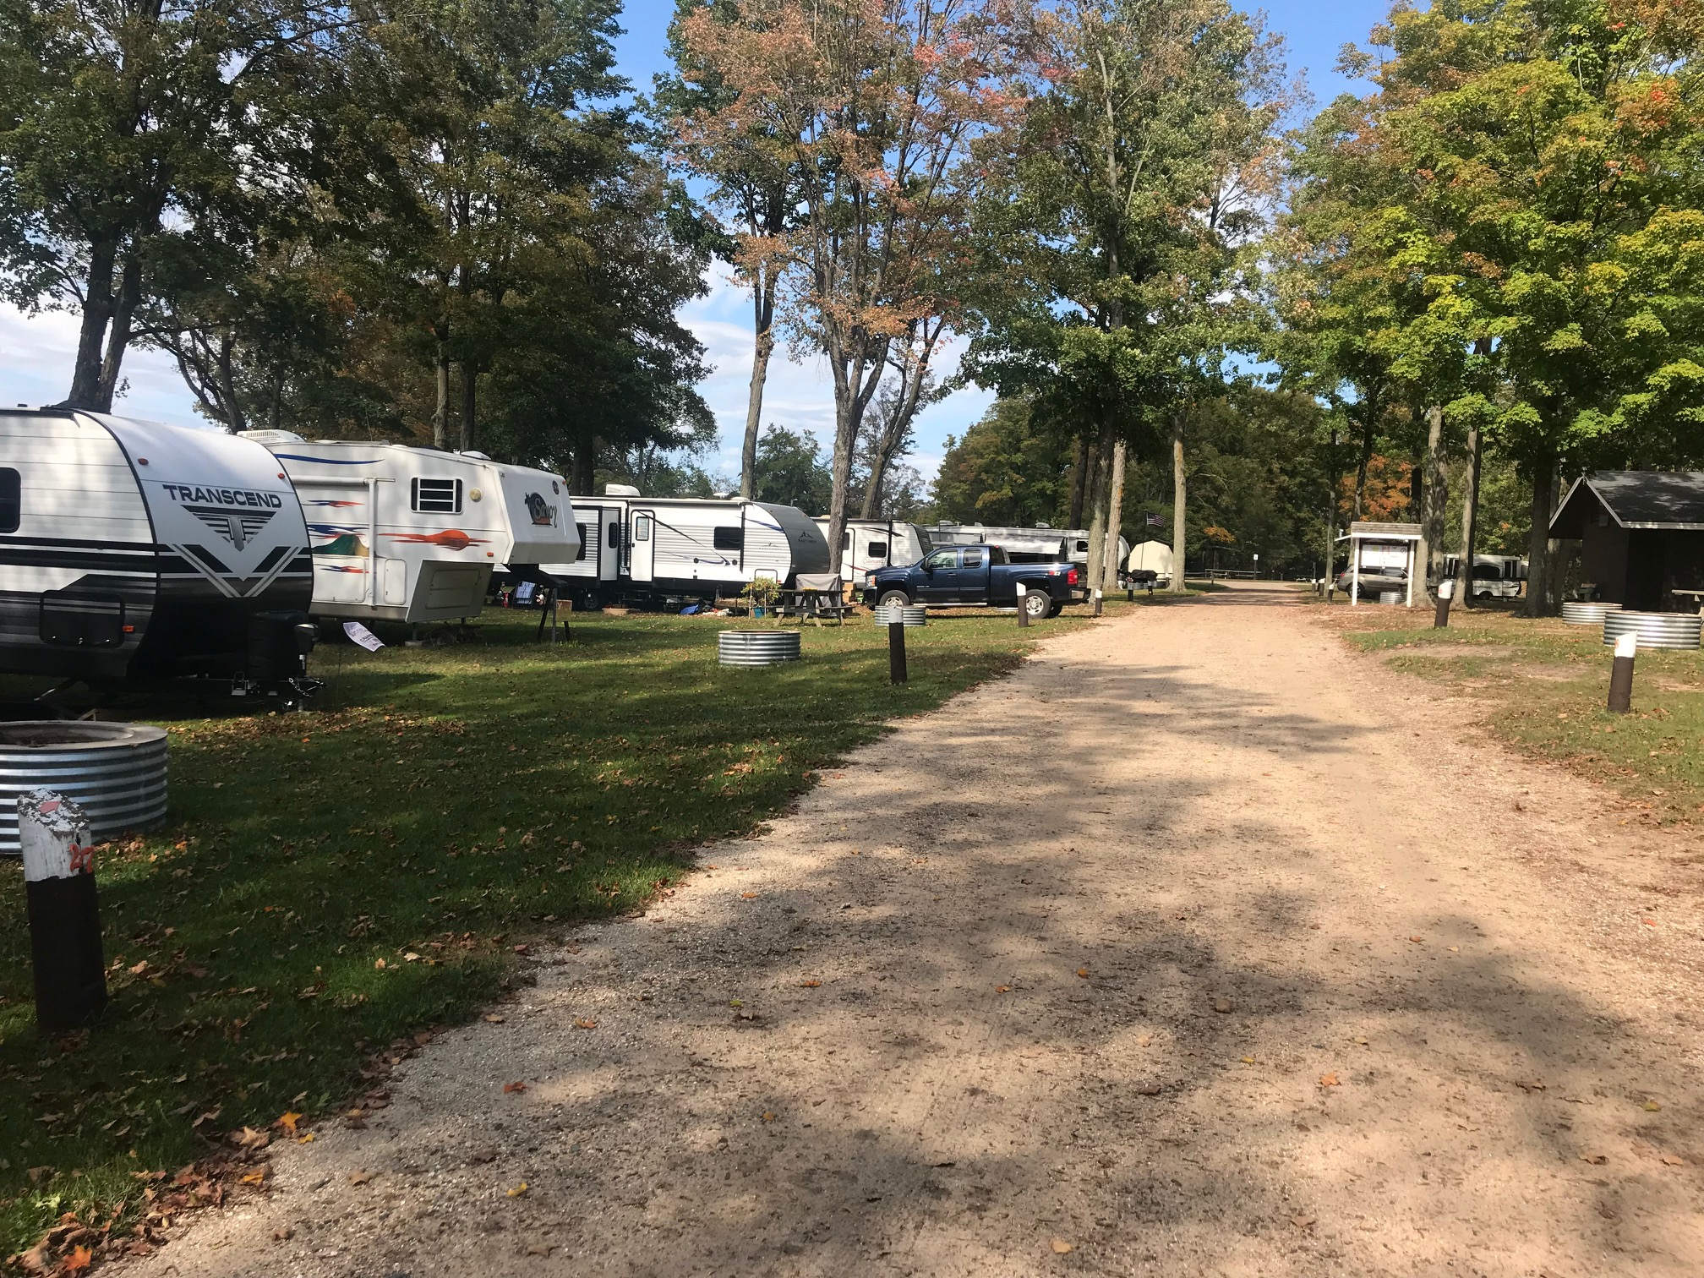

Slide 70
Rules & Regulations
Parks overview
Notes:
Not a list of all rules and regs
List of frequently broken rules

Slide 71
Speed Limit
10 MPH
Notes:
It can be helpful to drive a vehicle 10 MPH in front of the park staff so everyone has a visual of an acceptable speed

Slide 72
Quiet Hours
10:00 p.m. - 8:00 a.m.
Non-camping visitors are not permitted during quiet hours
Notes:
Quiet time must be observed between the hours of 10:00 p.m. and 8:00 a.m. for the benefit of those who retire early.

Slide 73
Campsite Cleanliness
No person shall:
Store many items under or around camper.
Allow campsite to become cluttered or unkempt
Notes:
Campsite grounds shall be kept free of personal property which may impede the staff’s ability to trim and maintain the grounds. Individual campsite cleanliness standards shall be at the discretion of the campground management and staff. Cannot become cluttered or unkempt in a manner that will reflect negatively on the Park Commission.

Slide 74
Outside Refrigerators
No person shall:
Utilize outside refrigeration equipment > 5.5 cubic feet and > than 36” tall
Have more than one outside refrigeration device per lot

Slide 75
Campsite Rules (Continued)
Wash off
Wash off camping units, vehicles or personal equipment
Wood
Store more than one face cord (8 ft. x 4 ft. stack) of firewood on a campsite.
Water
Water grass on campsites unless utilizing an in-hand spray nozzle. Watering of roadways is strictly prohibited.
Notes:
Use the park grounds to provide services, vending, or business operations which result in a direct financial benefit, unless prior written consent from the Park Superintendent or designee has been granted.

Slide 76
Campground Rules
No person may use the park grounds to provide services, vending, or business operations

Slide 77
Campsite Rules (Continued)
Guests are allowed to cut the grass between 10:00 a.m. – 6:00 p.m.
Washing of camping units, vehicles or personal equipment is strictly prohibited.
Notes:
(guests may not borrow MCP equipment).

Slide 78
Alcohol Policy
No distribution.
No kegs.
No bulk containers.
12-oz beer/wine cooler
750-ml (wine bottle)
Notes:
Only allowed for personal consumption in moderate amounts.
750-ml container wine bottle

Slide 79
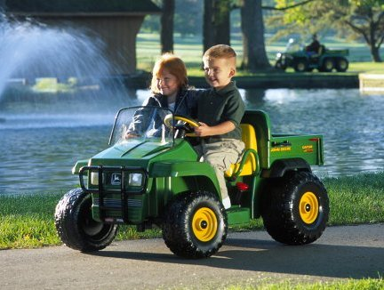
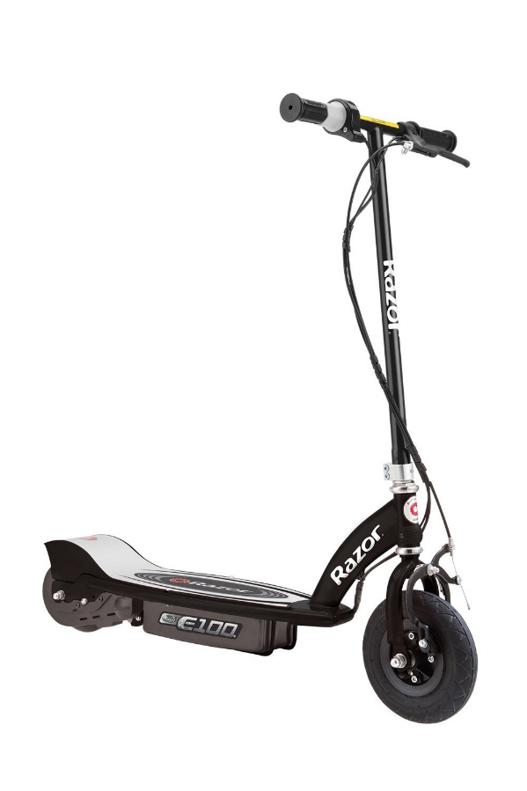
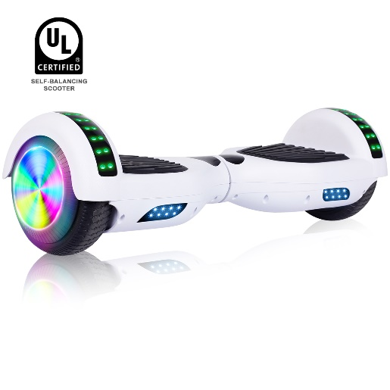
Battery Operated Toys
No:
Battery operated ride-on toys
Hoverboards
Electric Scooters
Unlicensed motorized vehicles
Vehicles not licensed for roadway use
Notes:
Battery operated ride-on toys, unlicensed motorized vehicles and vehicles not licensed for roadway use are not allowed in the parks due to safety and liability issues.

Slide 80
Bicycles
No riding bicycles after the street lights turn on (dusk) for safety.
Bicycles are not allowed on the beach.
Notes:
Bicycles must be walked back to the campsites at this time.

Slide 81
Riding In Back of Pickups & Towed Equipment
No riding in or on
the bed, tailgate, or outside portions of a motor vehicle
towed equipment (with the exception of park sponsored activities)

Slide 82
Riding In Back of Pickups & Towed Equipment

Slide 83
Storage Sheds
Storage shed size shall not exceed 6’ x 8.’
Only one per site.
Shed shall be made in sections that are easily removable.
Notes:
Covered trailers could be kept on a campsite as the one utility trailer allowed, and used as storage.

Slide 84
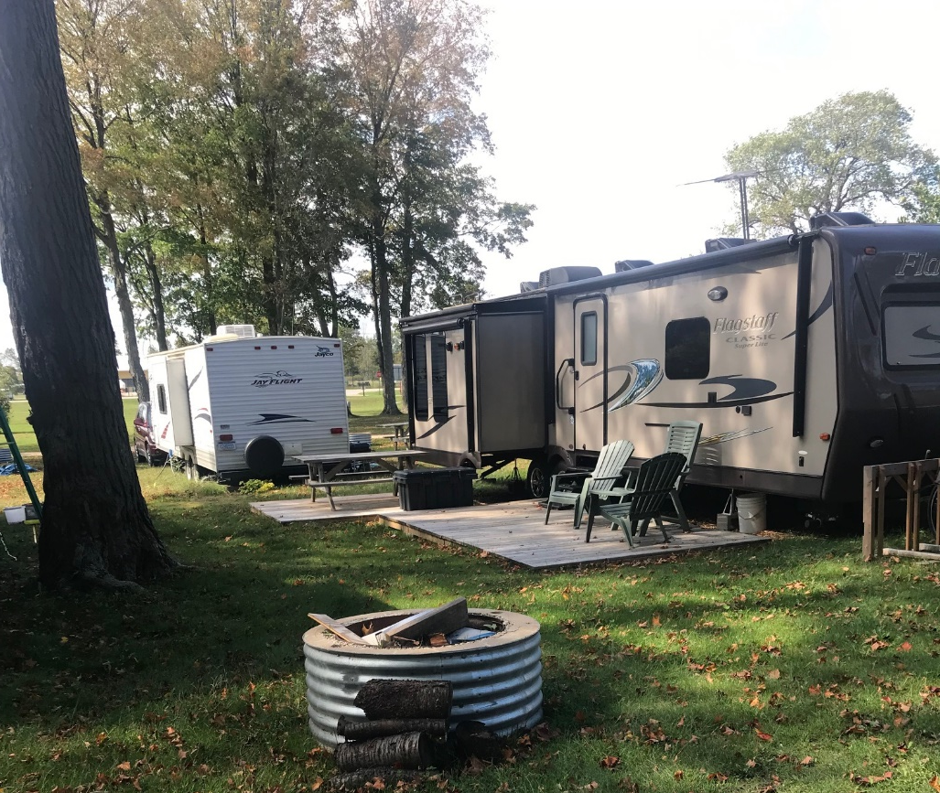
Patio
Patio size shall not exceed 8’ x 20’ (Ramp and/or steps included)
Notes:
Covered trailers could be kept on a campsite as the one utility trailer allowed, and used as storage.

Slide 85
Patio
Patio size shall not exceed 8’ x 20’ (Ramp and/or steps included)

Slide 86
Decks
Notes:
Covered trailers could be kept on a campsite as the one utility trailer allowed, and used as storage.

Slide 87
Speakers/Amplified Sounds
PA use must be approved through Superintendent
Sound can’t go beyond campsite boundaries or a reasonable distance when used in a public area
Notes:
Sound can’t go beyond campsite boundaries or a reasonable distance when used in a public area

Slide 88
Vehicle & Boat Passes
Required for any vehicle entering the park
Required for boats at Brower, and any boat using a mooring post

Slide 89
15 Minute Pass
Dropping off or picking up a camping unit.
Driving through the park for the first time.
Notes:
Used for a visitor who is:
Dropping off or picking up a camping unit.
Driving through the park for the first time.
Fifteen minute passes are available at no cost to visitors who will be in the park for 15 minutes or less.
Note: If the visitor stays in the park for longer than 15 minutes (i.e. for dinner or a visit) they must purchase a vehicle pass even if they are only staying for about an hour.

Slide 90
Vehicle & Boat Passes

Slide 91
Daily Vehicle/Daily Boat Passes
$7.00
Valid until 10 PM overnight requires two daily vehicle passes
Utilized by daily visitors or one-time visit campers
Shows the vehicle color and make & date of departure

Slide 92
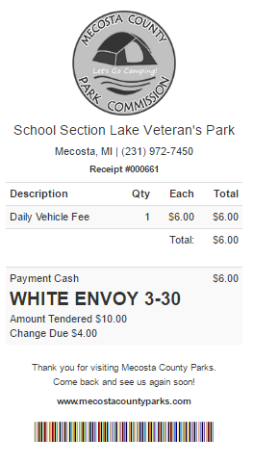
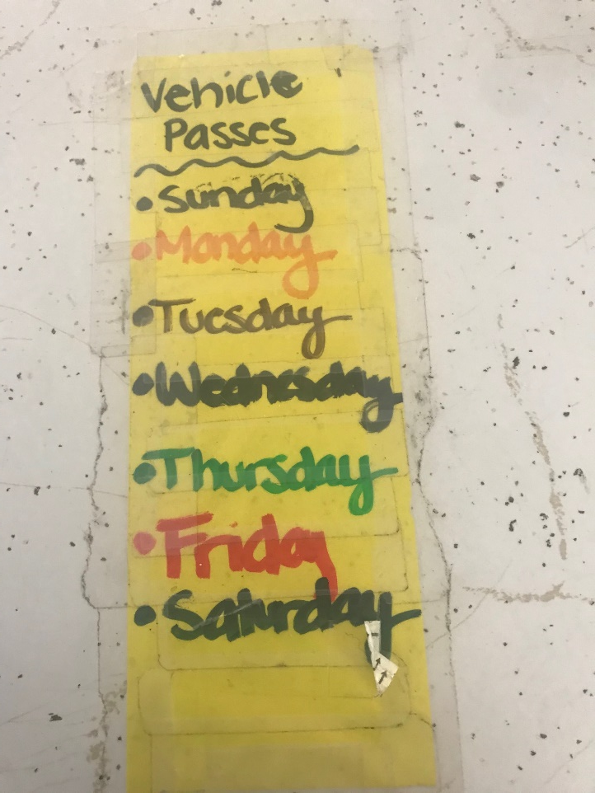
Daily Vehicle/Daily Boat Passes
Write date in color of last day paid
3-30

Slide 94
Season Passes
Valid for the entire summer season at any Mecosta County Park
Must be permanently affixed and are not transferrable to another vehicle
Numbered for tracking purpose

Slide 95
Vehicle Pass Requirements
Must be affixed to vehicles including:
Motorcycles – can have the pass in their wallet
Golf carts
Motor homes when there is no vehicle traveling with the motorhome
Notes:
Every vehicle must have a pass to enter the park; price of pass not included in camping cost.
Passes must be purchased and affixed to vehicles including:
Motorcycles – can have the pass in their wallet
Golf carts
Motor homes when there is no vehicle traveling with the motorhome
Note: The Recreation Passport sticker which can be purchased with a license plate renewal provides access to Michigan State Parks and Recreation areas. Since we are a county park, this pass does not allow access to our campgrounds.

Slide 96
Season Vehicle Passes
$30.00
Utilized by:
seasonal campers
long term stays
those who visit many times

Slide 97
Season Vehicle Passes
Mecosta County Resident
Non-Resident

Slide 98
Boat Pass Requirements
Permanently affixed: passenger side next to MC #s
Need name and phone # on file
Required for every boat at Brower, Season pass required if using mooring posts

Slide 99
Seasonal – Season Boat
$30.00
Required for seasonal campers who moor

Slide 100
Season Boat - Transient/Daily
$30.00
Required to use mooring posts

Slide 101
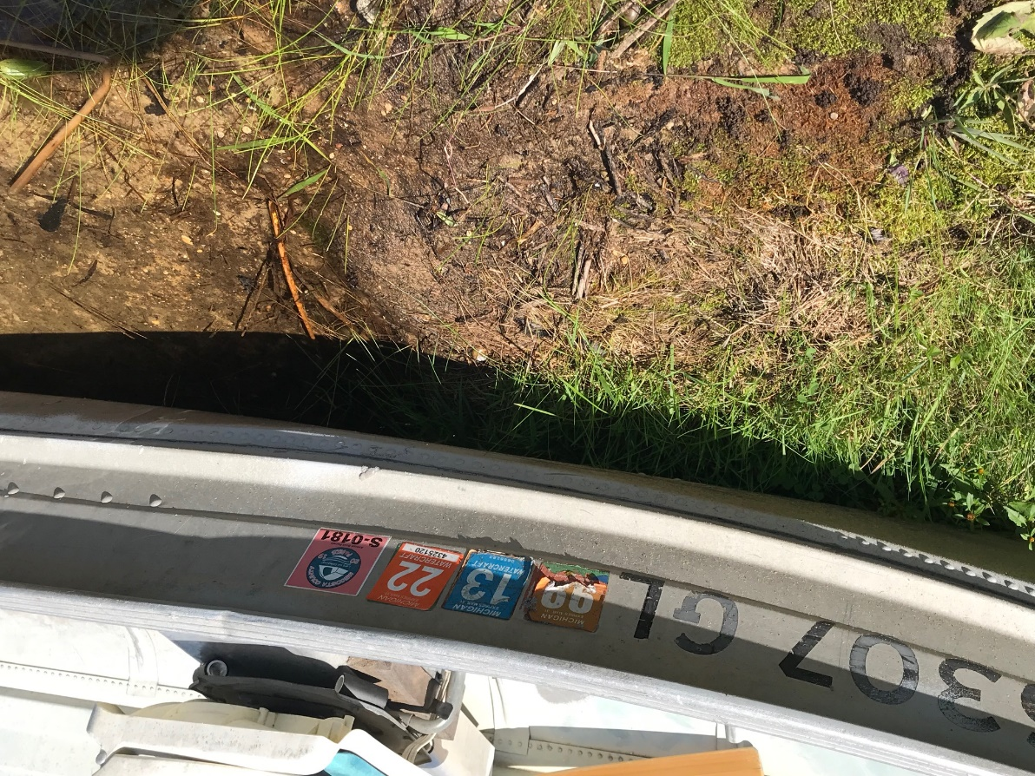
Boat Pass Requirements

Slide 102
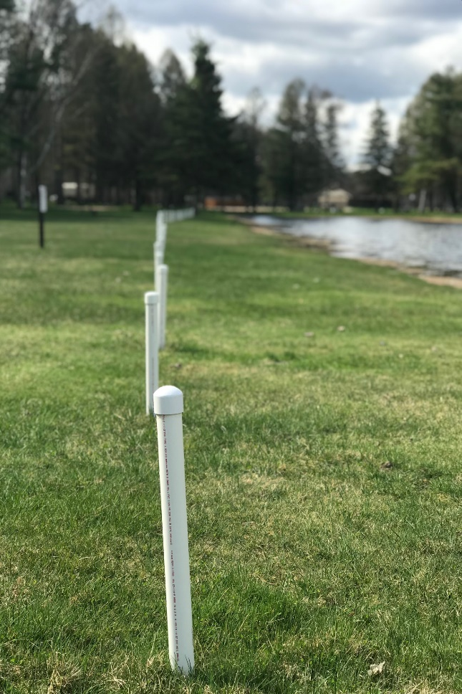
Mooring Posts
Notes:
Two people may moor at one post.

Slide 103
Mooring Posts
Boats may only be moored or anchored in designated areas.
Mooring posts are available on a first come first serve basis.
Reserving of a specific mooring post is prohibited.
Notes:
Two people may moor at one post.

Slide 104
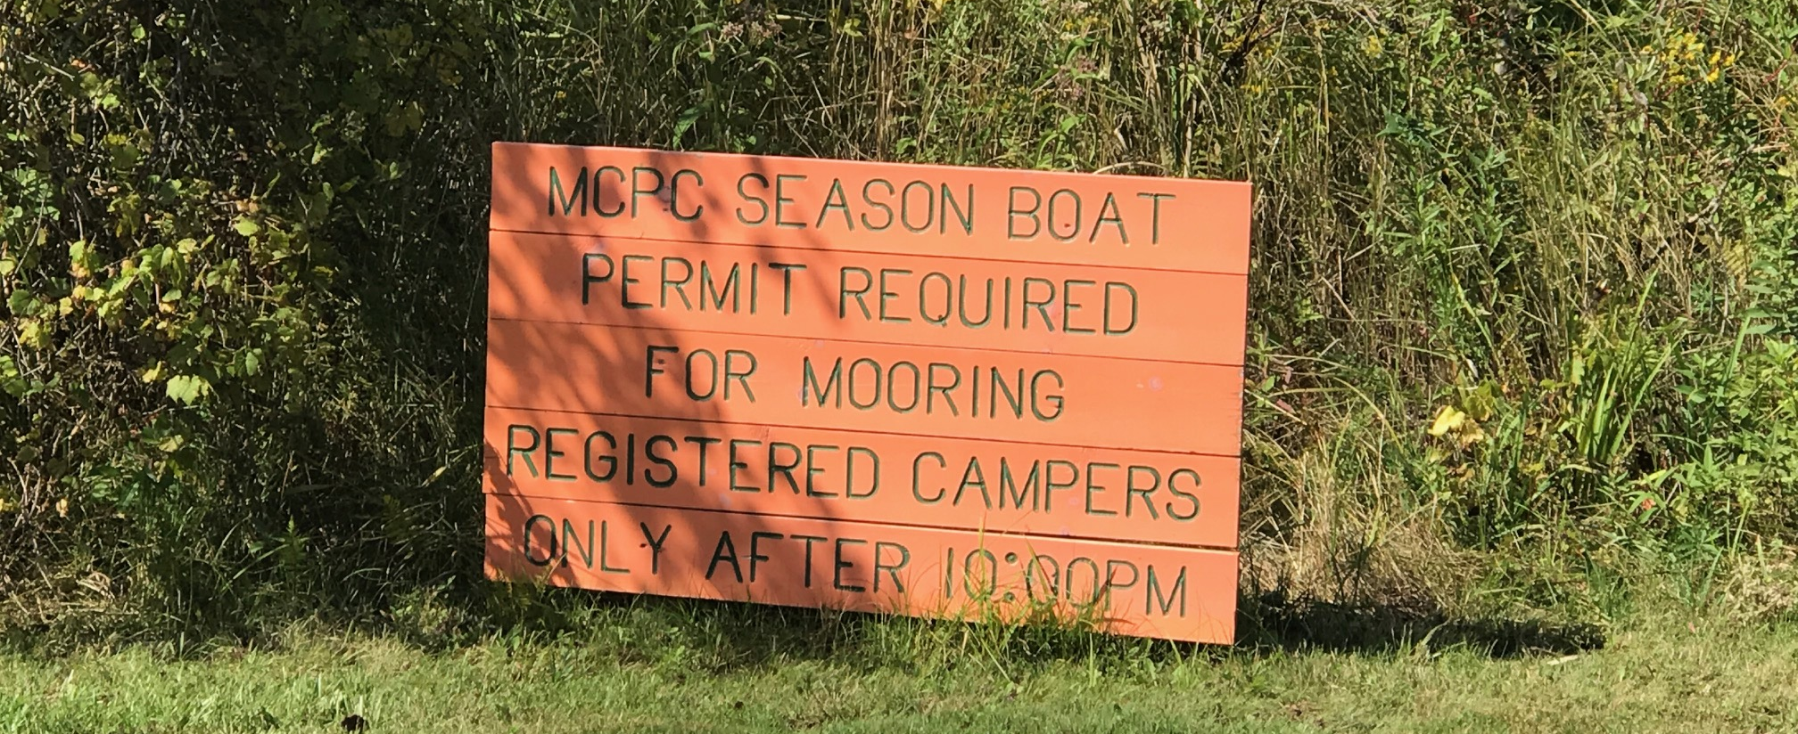
Mooring Posts
Notes:
Two people may moor at one post.

Slide 105
Watercrafts
Only registered camping guest may leave boat overnight.
Boats must leave park after camping trip over.
Notes:
A person must be a current registered camping guest at the park to leave a boat overnight.
Boats must leave park after camping trip over.

Slide 106
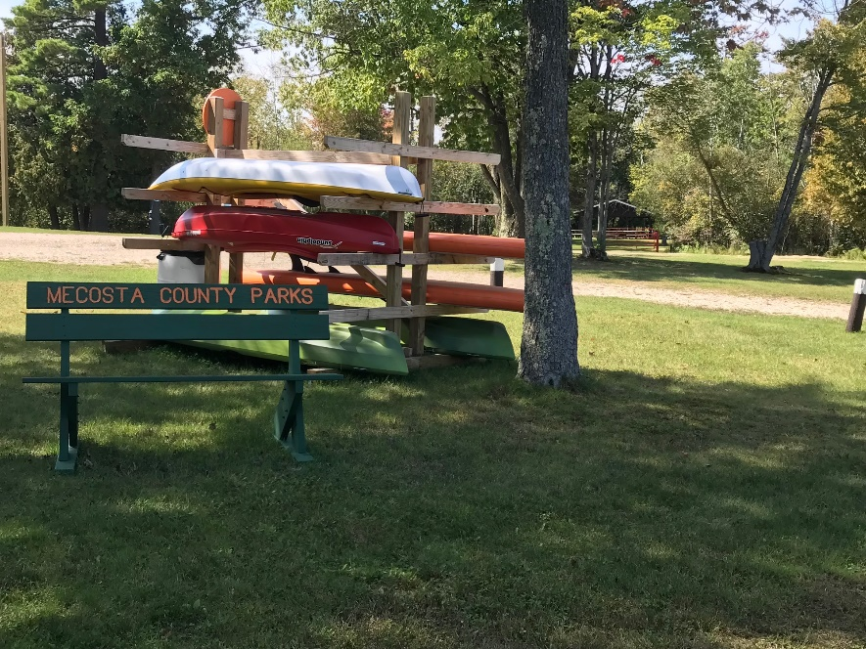
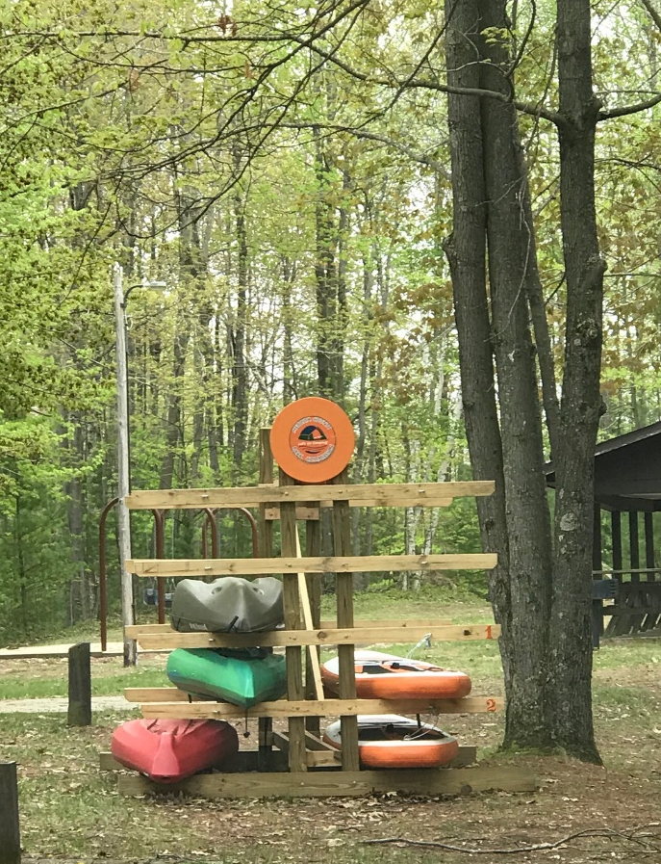
Kayaks/Canoes
Notes:
No passes required for Kayaks/Canoes

Slide 107
Boat Trailers & Utility Trailers Must Be:
Placed on a campsite
Attached to a tow vehicle or
Removed from the park.
Notes:
Trailers cannot be left in overflow parking areas without being attached to a vehicle (even if just the visitor is just running to the store).
Note: the only exception is the boat trailer parking area at Brower Park.

Slide 108
Boat Trailers & Utility Trailers
Note: the only exception is the boat trailer parking area at Brower Park.
Notes:
Trailers cannot be left in overflow parking areas without being attached to a vehicle (even if just the visitor is just running to the store).

Slide 109
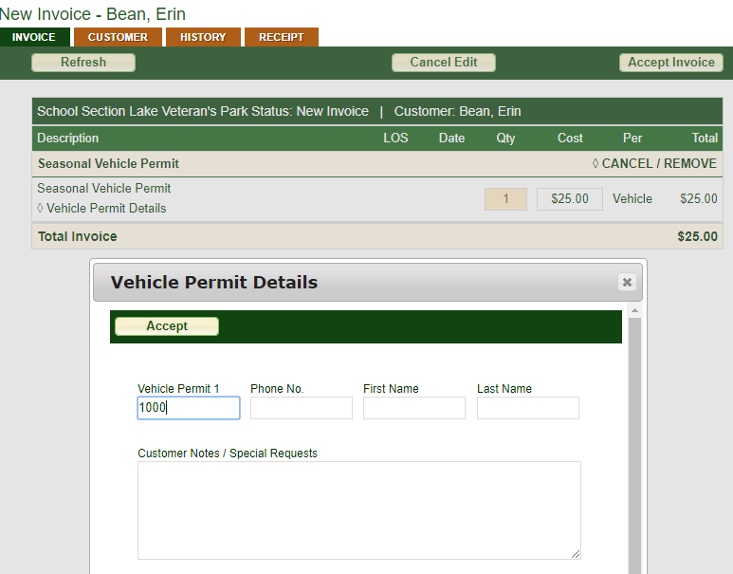
Vehicle/Boat Permit Tracking
Entered into the system and stored in a database
If in violation, the owner will be contacted.

Slide 110
Boat Permit Tracking
Boat Permits will be sold through an invoice with a name
Permit number will be entered and stored
Boat owner can be tracked through the database

Slide 111
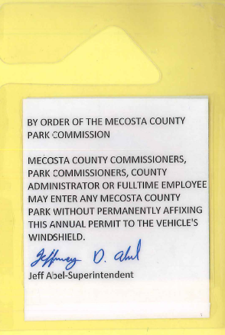
Hang Tags
Annual vehicle tags that hang from the rear-view mirror
Issued to County Officials and Fulltime staff
Notes:
Last name of individual included
County personnel must be present to use pass

Slide 112
Lifetime Pass Hang Tags
Lifetime pass logos are provided to any Board Member who served for more than 15 years.

Slide 113
Park Improvements 2018-19
Wi-Fi at Brower
Wi-Fi at School Section
Extension to Brower Park Boat Launch
Egg Nest Destruction at Brower Park
Goose Round up at Brower Park
Trout Rearing Partnership with DNR
Addition of Sturgeon to Ponds
Baby changing stations in Men’s and Women’s Restrooms
Kayak rack
Upgrades to SS Concessions Store

Slide 114
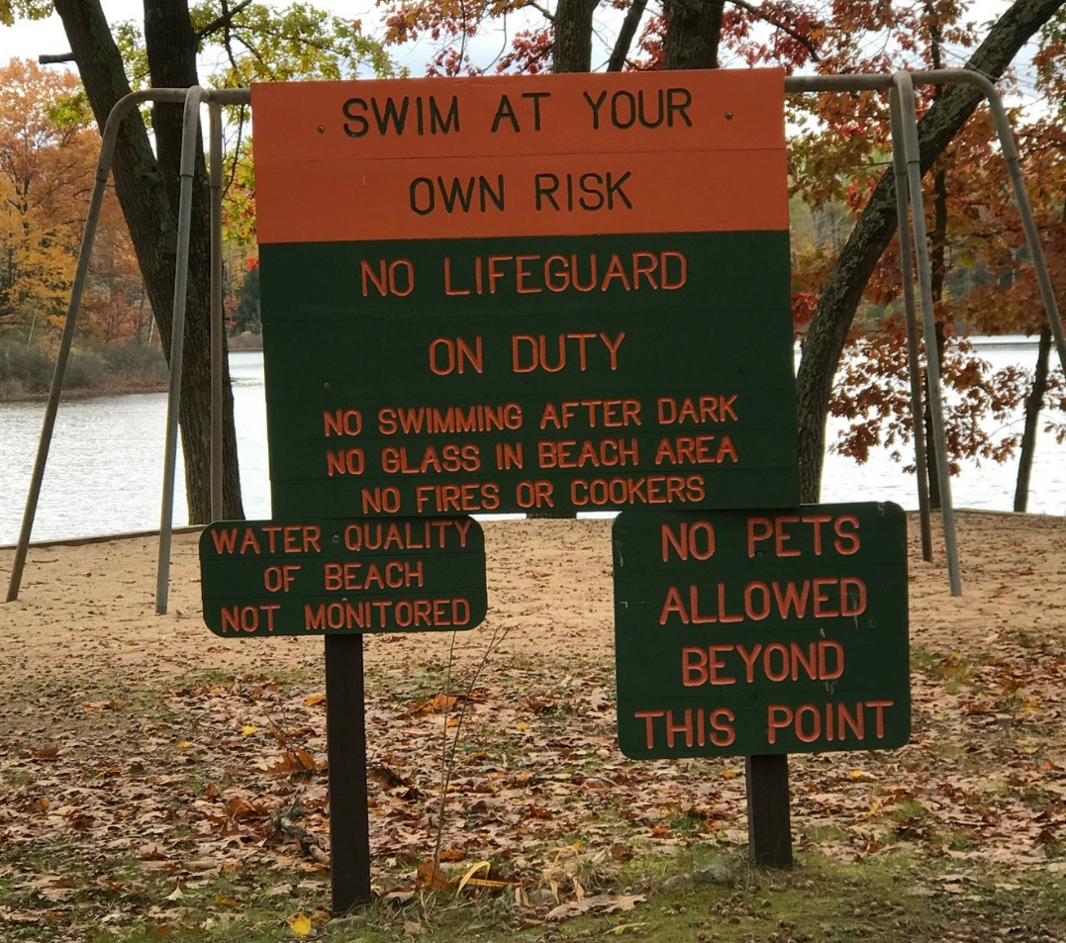
Swimming Area

Slide 115
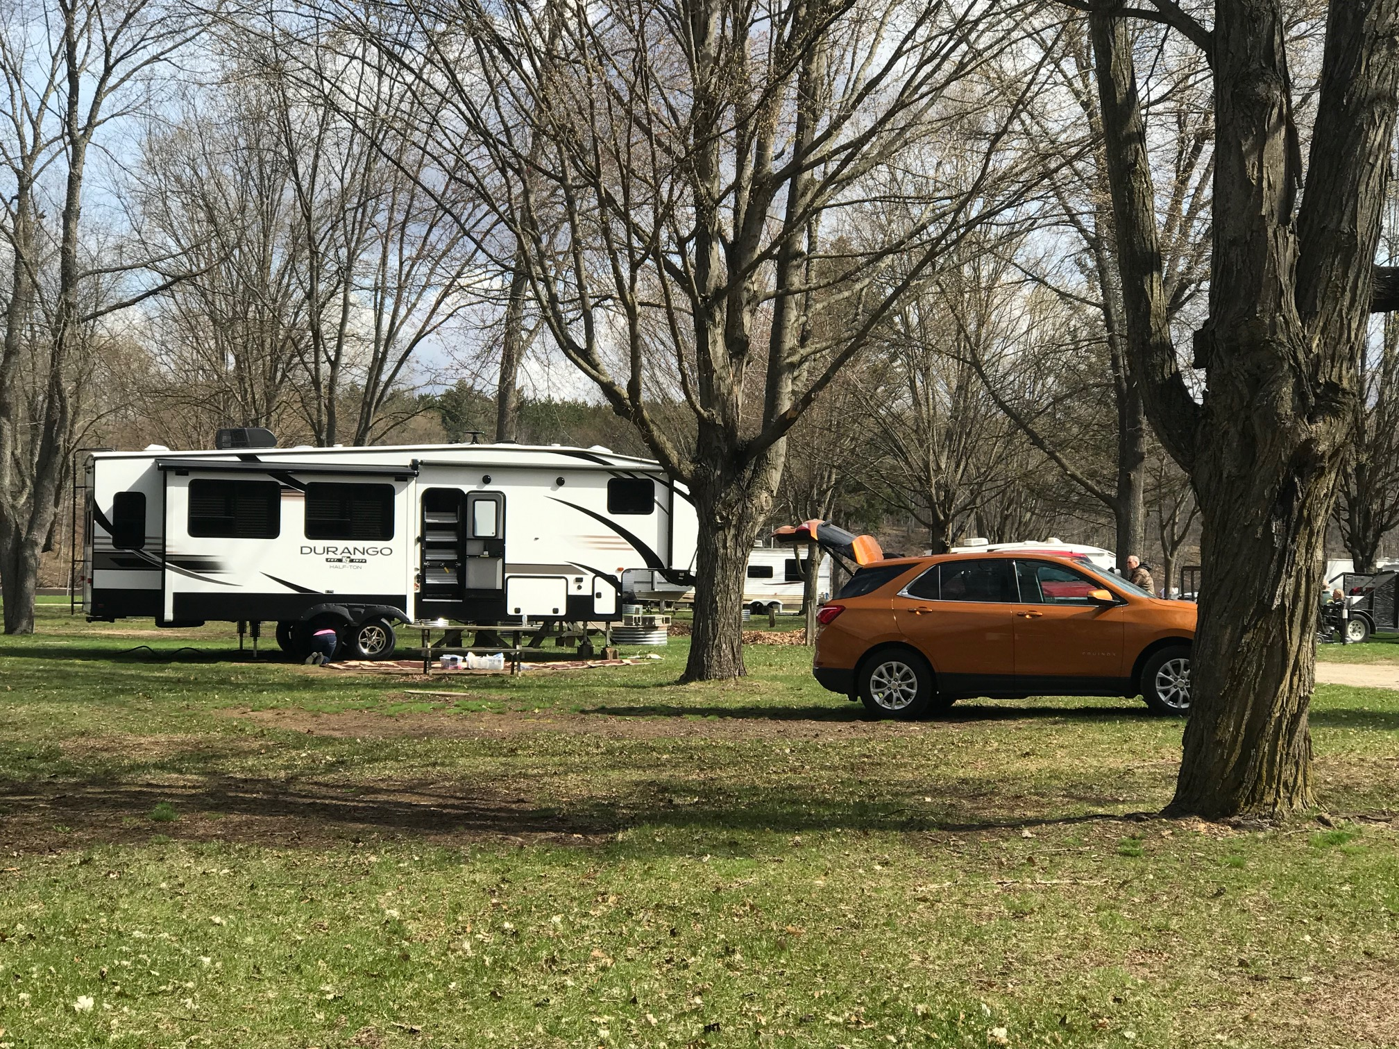
Park Improvements 2018-19

Slide 116
Policies
Parks overview

Slide 117
2021 Refund Policy
Requests submitted in writing to admin@mecostacountyparks.com
$5.00 Reservation Fee always non-refundable
Credit cards refunded to card
Cash or checks: up to 45 days for check refund
Requests for exceptions will not be considered
Notes:
Completed at admin office

Slide 118
Refund Policy: Nightly Camping – Greater than two weeks before start
Standard Rate
Holiday Rate
Full refund - ($10.00 per campsite Admin. Fee)*
75% refund*
Notes:
Fee is now per campsite
$5.00 Reservation Fee always non-refundable
No refund will be given for a cancellation on/after the scheduled date of arrival.
Reservations canceled on the same day they are created will be assessed the $5 reservation fee.

Slide 119
Refund Policy: Nightly Camping – Greater than two weeks before start
Standard Rate
Holiday Rate
Full refund - ($10.00 per campsite Admin. Fee)*
75% refund*
Notes:
Fee is now per campsite
$5.00 Reservation Fee always non-refundable
No refund will be given for a cancellation on/after the scheduled date of arrival.
Reservations canceled on the same day they are created will be assessed the $5 reservation fee.

Slide 120
Refund Policy: Nightly Camping – Less Than Two Weeks Before Start
No refund
50% refund*
Less than 14 days Before Arrival
On or After Scheduled Arrival
Notes:
Fee is now per campsite
$5.00 Reservation Fee always non-refundable
No refund will be given for a cancellation on/after the scheduled date of arrival.
Reservations canceled on the same day they are created will be assessed the $5 reservation fee.

Slide 121
Changes to Reservation
More than 14 days Before Arrival & Equal or Greater Monetary Value
Within 14 days of Arrival or Decrease in Monetary Value
Follow cancellation policy & make new reservation
$10.00 per campsite Modification Fee*
Notes:
Fee is now per campsite
$5.00 Reservation Fee always non-refundable
No refund will be given for a cancellation on/after the scheduled date of arrival.
Reservations canceled on the same day they are created will be assessed the $5 reservation fee.

Slide 122
Refund Policy: Monthly Camping – Greater than two weeks before start
Full refund - ($100.00 per campsite Admin. Fee)*
50% refund*
More than 14 days Before Arrival
Less than 14 days Before Arrival
Notes:
Fee is now per campsite
$5.00 Reservation Fee always non-refundable
No refund will be given for a cancellation on/after the scheduled date of arrival.
Reservations canceled on the same day they are created will be assessed the $5 reservation fee.

Slide 123
Refund Policy: Monthly – After Camping Has Begun
Pro-rated to nightly + $100 Admin Fee*
(Not greater than 50% of reservation.)
Notes:
Fee is now per campsite
$5.00 Reservation Fee always non-refundable
No refund will be given for a cancellation on/after the scheduled date of arrival.
Reservations canceled on the same day they are created will be assessed the $5 reservation fee.

Slide 124
Refund Policy - Seasonals
All seasonal campsite refunds are subject to a $50.00 administrative fee.
Seasonal deposits are non-refundable after January 23rd. (Brower exception)
Notes:
Some flexibility here with Governor’s Executive Order

Slide 125
Refund Policy: Partial Seasonals
Pro-rated from seasonal to monthly or nightly + $100 Admin. Fee
No refunds on seasonal sites will be given for changes in park operation dates.

Slide 126
Refund Policy – Picnic Shelter
Before March 31st – full refund less $10 Administration fee and $5 reservation fee.
April 1st and after – 14 days advance notice = 50% refund less the $5 reservation fee.
Within 14 days of arrival = no refund.

Slide 127
Refund Policy – Family Group Camp
Before March 31st – full refund less $50 Admin fee and $5 reservation fee.
April 1st and after – 14 days advance notice = 50% refund less the $5 reservation fee.
Within 14 days of arrival = no refund.

Slide 128
Refund Policy

Slide 129
Low Speed Vehicles (LSVs)
Allowed at Brower Park
No unregistered, unlicensed vehicles such as ATV’s, UTV’s and ORV’s are allowed in Brower Park.
Notes:
All Low Speed Vehicles (LSV’s) must be licensed and registered by the State.
All LSV’s must maintain their safety road legal equipment.
All LSV’s will be treated as any other licensed and registered vehicles.
The speed limit is 10 MPH.
One person seated per seat, no standing and no open alcohol containers.
Absolutely no driver will be allowed to operate while intoxicated or impaired.
All LSV’s MUST stay on designated roadways and vehicle parking, and are NOT allowed on the beach, waterfront front or grass areas.
All LSV’s MUST be registered at the Park office and require a Park Window Decal and will be counted as a motor vehicle towards the number of vehicles allowed on each site.
No unregistered, unlicensed vehicles such as ATV’s, UTV’s and ORV’s are allowed in Brower Park.

Slide 130
Geocaching Policy
Geocaching is an outdoor activity in which participants use a GPS to navigate a hidden object.
Geocaching is permitted in the parks as long as it is done in a responsible manner.

Slide 131
Geocaching

Slide 132
Excessive Use of Power
Discourage excessive use of power; for example, leaving patio lights and bug zappers on after campers retire for the night.
The use of inadequate or defective power cords should also be discouraged.
Notes:
Every effort must be made to discourage excessive use of power; for example, leaving patio lights and bug zappers on after campers retire for the night.
The use of inadequate or defective power cords should also be discouraged.

Slide 133
Seepage Pits
No more seepage pits may be installed
Must have seepage pit to discharge grey water
Seepage pit removed if fails
Sharing allowed with permission of camper on seepage lot.
Only two units may use each seepage pit.
Notes:
Each park has a map of the sites which currently have a seepage pit installed.

Slide 134
Violation Notice
Notes:
A valid daily or annual vehicle pass must be displayed on the windshield of any vehicle entering the park. Visit the park office during the hours of 8 am and 9 pm to purchase your vehicle pass.

Slide 135
Office Hours
Set by the management team
No set schedule every day
Vary hours the office is open
Notes:
Office hours should be set by the management team and should not be the same every day.
Please take into consideration the needs of the campground and check-in times while determining off season office hours.
The campers in the park should have a time where they know they can come to the office daily. Post one set of hours where the office is open daily. Beyond that time, setting office hours is up to the management team.
Sometimes, if the hours have been posted publicly, have someone in the office during times it was posted for the office to be closed, to ensure that visitors are not taking advantage of entering the park when the office hours are posted as closed.

Slide 136
Office Hours
Notes:
Office hours should be set by the management team and should not be the same every day.
Please take into consideration the needs of the campground and check-in times while determining off season office hours.
The campers in the park should have a time where they know they can come to the office daily. Post one set of hours where the office is open daily. Beyond that time, setting office hours is up to the management team.
Sometimes, if the hours have been posted publicly, have someone in the office during times it was posted for the office to be closed, to ensure that visitors are not taking advantage of entering the park when the office hours are posted as closed.

Slide 137
Manager on Duty
Notes:
Office hours should be set by the management team and should not be the same every day.
Please take into consideration the needs of the campground and check-in times while determining off season office hours.
The campers in the park should have a time where they know they can come to the office daily. Post one set of hours where the office is open daily. Beyond that time, setting office hours is up to the management team.
Sometimes, if the hours have been posted publicly, have someone in the office during times it was posted for the office to be closed, to ensure that visitors are not taking advantage of entering the park when the office hours are posted as closed.

Slide 138
Abandonment – Vehicle/Boat
Vehicles or boats without passes will be considered abandoned and will be towed at the owner’s expense.
Notify Superintendent for Towing procedures.

Slide 139
Written Notice of Eviction
Managers may temporarily evict visitors
Superintendent will determine if the eviction is:
not upheld, or
upheld with a term of eviction.
Contact the Sherriff’s office to assist with eviction if needed.
Notes:
Managers have the authority to evict visitors from the campground if necessary.
If there is time and the situation allows please reach out to the Superintendent or Operations Manager to explain the situation.
The Eviction is a temporary eviction until the situation is reviewed by the Superintendent.
The Superintendent will determine if the eviction is not upheld, or is upheld with a term of eviction.
Contact the Sherriff’s office to assist with eviction if needed.
An eviction form is available in the Form tote.

Slide 141
https://youtu.be/7PB5TcYWUfc

Slide 142
Park Operations & Procedures
Mecosta County Parks

Slide 143
Park Procedures
Mecosta County Parks

Slide 144
Maintenance Requests
Full-Time maintenance staff will work weekends
Call with issues on weekends (after checking situation)
Send email to Operations Manager or Superintendent
Do not contact Maintenance on Monday and Tuesday
Notes:
If an issue takes place on a weekend which requires immediate attention, it would be acceptable to call the Operations Manager or the Superintendent who would direct the Full-Time Maintenance crew to come to the park and take care of the concern, or ask the staff to wait until Monday when the situation could be addressed.
The manager should always inspect the situation and then use discretion to determine if the issue needs immediate attention, or if it would be acceptable to wait until Monday.

Slide 145
Maintenance Requests
Taken care of by someone within the park
Full-Time Maintenance crew with issues that cannot be fixed by seasonal park staff.
Notes:
Maintenance request should be added to a form on a clipboard inside the office where the year-round maintenance crew can access it when they arrive at the park.
Two lists should be developed – one list that can be taken care of by Roving Ranger workers or someone within the park, and one list for the Full-Time Maintenance crew with issues that cannot be fixed by seasonal park staff.
If an issue takes place on a weekend which requires immediate attention, it would be acceptable to call the Full-Time Maintenance crew to come to the park and take care of the concern. The manager should always inspect the situation and then use discretion to determine if the issue needs immediate attention, or if it would be acceptable to wait until Monday.

Slide 146
Supply Order Forms
Laminated copy available
Send to Admin electronically on Tuesday
Each order will be filled and returned to the park Thursday or Friday
Verify order and record delivered items
Some items may be backordered
Notes:
Cleaning and office supplies are purchased in bulk and stored at the Administrative Office.
A laminated copy of the supply order form has been provided and should be placed in an area where all staff can see it. This paper copy of the list should be filled with items that each staff member needs for the week by Monday night.
Each order will be filled at the Administrative Office and returned to the park either on Thursday or Friday.
When the items are delivered to the park it is necessary to verify the order and record the actual items delivered onto the spreadsheet on the computer.
Any items not shipped will be marked as backordered and will be sent as soon as possible.

Slide 147
Cleaning and Office Supply Order
Items added to the supply list should be routine items.
Maintenance items added to maintenance list
Notes:
Items required for maintenance issues (something needed to fix a problem) should be added to the maintenance list in the parks so the maintenance men can look over the issue and determine what is needed.

Slide 148
Cleaning & Office Supply Order
Notes:
Items required for maintenance issues (something needed to fix a problem) should be added to the maintenance list in the parks so the maintenance men can look over the issue and determine what is needed.

Slide 149
Wood in Parks
Campers may:
Bring their own wood
Purchase wood from parks (loose or bundled)
Buy from approved wood vendor

Slide 150
Wood Vendors
Notes:
Campers order directly with the vendor for one face cord only
Up to three wood vendors will be assigned per campground
Vendor will be advertised in the campground as the sole provider for bulk wood deliveries.
Orders are to be placed by campers directly with the vendor.
Orders must be for a rick/face cord of wood only. (4 ft by 8 ft stack with 16 inch pieces)
Only pre-ordered wood is to be brought into the campground.
Wood must be stacked on the visitor’s campsite when it is delivered by the wood vendor.
Before entering the park the vendor is to supply the campground office with a list (in writing) of the campsite(s) where they are delivering wood. These slips will be sent from the campground office to our parks administration office weekly.
$5/campsite delivery will be charged to the wood vendor by the Mecosta County Parks.

Slide 151
Sports Equipment
Available to borrow at park office
Keep track of site number or name
Make sure items are returned
Notes:
The parks supply some sporting equipment that visitors can borrow.
A sheet should be kept with lot of guest, or a Driver’s License # or License Plate Number for day use guests.
Equipment should be returned in the same condition as received

Slide 152
Lost and Found
Fill out the Record of Lost and Found items for any items lost or found in the park.
Keep in office in tote or box
Any items of value should be stored in the manager’s safe.

Slide 153
Community Service
Community Service Workers Cannot:
Drive our pick up trucks
Tractors
Gators or
Operate the chainsaw or riding lawnmowers.
Notes:
Community Service workers will assist with general duties as specified by the Managers of each park. Only Managers can sign their time sheets. Community Service workers are to be supervised and treated with dignity and respect. Community service workers check in with the staff upon their arrival and before departure.
Community Service workers cannot:
Drive our pick up trucks
Tractors
Gators or
Operate the chainsaw or riding lawnmowers.

Slide 154
Community Service
Community Service Workers Can:
Split and Stack Wood
Push Mow
Weed Whip
Pick Up Trash
Notes:
Community Service workers will assist with general duties as specified by the Managers of each park. Only Managers can sign their time sheets. Community Service workers are to be supervised and treated with dignity and respect. Community service workers check in with the staff upon their arrival and before departure.
Community Service workers cannot:
Drive our pick up trucks
Tractors
Gators or
Operate the chainsaw or riding lawnmowers.

Slide 155
Volunteer Waiver Form
Any person volunteering must have an approved form.
Can be approved by the Park Manager.
Notes:
Any person volunteering for any activity or action with the park must have an approved volunteer form on file at the Park Office.
The volunteer must fill out the form and it will be approved by the Park Manager.

Slide 156
Art Barn
Brower Park and School Section Lake Veteran’s Park are equipped with an Art Barn for children’s activities.
Activities should be posted throughout the park to notify guests.

Slide 157
Special Events
Prepare and schedule daily activities & programs for a week or more in advance.
Post information in the park, in the Park Office and in the activity building.
Regularly inspect activity building and play areas for cleanliness.
Recruit volunteers.
Order supplies and equipment with the Park Manager approval.
Work with children, teenagers and adults with arts and craft projects.
Ride and keep guests safe during the wagon rides. (Brower Park)
Hold movie night. (Brower and School Section)
Notes:
Any person volunteering for any activity or action with the park must have an approved volunteer form on file at the Park Office.
The volunteer must fill out the form and it will be approved by the Park Manager.

Slide 158
Special Events
Notes:
Any person volunteering for any activity or action with the park must have an approved volunteer form on file at the Park Office.
The volunteer must fill out the form and it will be approved by the Park Manager.

Slide 159
Special Events
Notes:
Any person volunteering for any activity or action with the park must have an approved volunteer form on file at the Park Office.
The volunteer must fill out the form and it will be approved by the Park Manager.

Slide 160
Special Events
Notes:
Any person volunteering for any activity or action with the park must have an approved volunteer form on file at the Park Office.
The volunteer must fill out the form and it will be approved by the Park Manager.

Slide 161
Motion Picture License
Brower and School Section have a license to show motion pictures.
G-Rated movies may be shown with no prior notice. A movie night which is promoted in the park ahead of time may show PG-Rated movies.

Slide 162
Pop Can Money for Events
Create labeled bins for pop can donations in the park
Any pop cans collected by the parks can be taken to the store and turned in for the deposit.
Money may be used to purchase supplies for children’s activities.
Receipts should be turned in to the administrative office with weekly paperwork.
Notes:
Create labeled bins for pop can donations in the park
Any pop cans collected by the parks can be taken to the store and turned in for the deposit.
Money may be used to purchase supplies for children’s activities.
Receipts should be turned in to the administrative office with weekly paperwork.

Slide 163
Procedure for Returning Cans
Pop cans must be returned by a park staff member during work hours, using a park vehicle.
The returning of cans and purchasing of supplies must occur in the same trip, and should show up on the same receipt in one transaction.
The receipts for the supplies and any remaining money must be turned in to the park office after each trip.
All receipts must be turned in to Admin at the end of the year.

Slide 164
Requesting Donations
Park employees must not request donations from community businesses for special events and prizes.
These items should be purchased with the pop can money.
Notes:
There are times where the Administrative Office sells advertising to assist with the cost of marketing materials.
When a business has provided the parks with several donations over the summer, it can affect a business choosing to advertise with the parks in the future.

Slide 165
Campground Full Signs
When the park is full and has no more available sites for rent (including oops sites) hang the campground full signs on the main park sign.

Slide 166
Flyers/Signs
Flyers and signs are to be displayed in the parks on our information boards.
Do not cover the windows of the park offices.
Only MCP flyers are to be displayed in the parks and offices.

Slide 167
Flyers/Signs

Slide 168
Campground Licenses
Campground Licenses must be displayed in the Park Office

Slide 169
Hospital Driving Directions
Every park has maps for hospital driving directions.
Every now and then, a guest is injured in the park and wants to drive themselves to the nearest hospital.
Please have these maps readily accessible where all staff know the location.
Notes:
Every now and then, a guest is injured in the park and wants to drive themselves to the nearest hospital.
Please have these maps readily accessible where all staff know the location.

